Slide 1


Effective Biological and Ecological Cleaning Solutions

Slide 2
Agenda
2

Slide 3




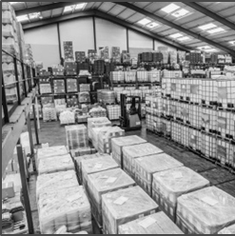
About Us
UK market leader in biological products
UK suppliers
In-house ‘cradle to grave’ service
32,000 sq ft production facility in Wales
ISO 9001:2015
ISO 14001:2015
UFAS & FAMI-QS
Manufacturing
R&D
Technical
and support
In house chemists and microbiologists
Purpose built labs
Sales and
Field Support
In house customer service
10 account managers
60 engineers

Slide 4

Things to be wary of…
False claims
CHSA Brief
https://www.chsa.co.uk/if-it-sounds-too-good-to-be-true-it-is-advice-from-the-chsa-on-false-claims/
Shortage of RM (plastic and chemical)
Choosing the right product - sanitiser accredited
Effective log reduction - Typically, a minimum of 5 log is required to ensure that contaminated areas can be disinfected.

Slide 5





BS EN 14476:2013+A2:2019
BS EN 14476:2013+A2:2019
BioHygiene All Purpose Sanitiser(s) and Washroom 4D Sanitiser have been approved to EN14476 against enveloped viruses as defined in EN 14476:2013 + A2:2019. This is valid for all coronaviruses including 2019 n-CoV / SARS-CoV-2. To clarify 2019 n-CoV or SARS-CoV-2 is the coronavirus responsible for the current outbreak and causes the disease known as COVID-19.

Slide 6


Touch points to clean…
The average person touches their face 23 times per hour
Door handles/plates
Computer keyboard/mouse
Toilet flushes
Taps (bathroom and kitchen)
Kettle switch/toaster
Tea/coffee/sugar pots
Fridge/freezer/oven pull handles
Keys
Remote controls, such as T.V

Slide 7



Health & Safety
Choose a product that has a low in-use hazard
Required PPE would be minimal
Concentrates will naturally be more hazardous

Slide 8
Key Performance Indicators
When considering a supplier change, try to accommodate more than one of your business KPI’s
Talk to your colleagues, find out if there are KPI’s internally:
Co2e
Plastic
Transport
Environmental
Financial
Reduced deliveries
Invoice consolidation
etc

Slide 9
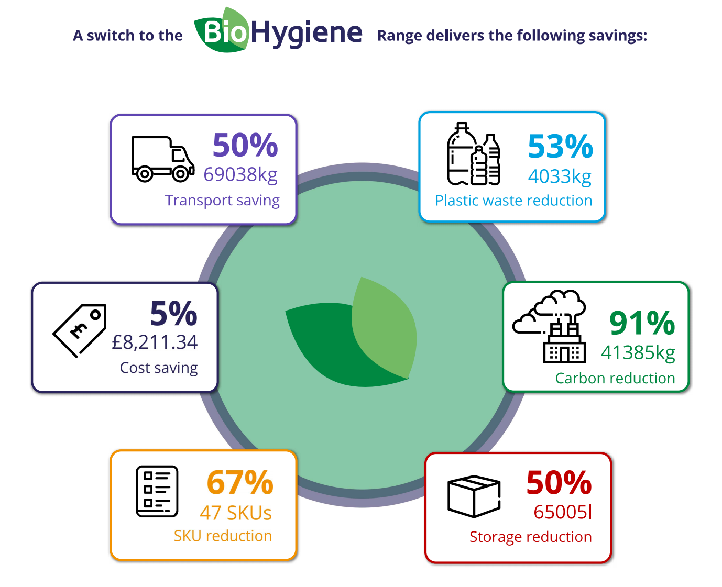
Yield analysis

Slide 10
Thank you
Any questions?
jnayler@biologicalpreparations.com
07974 700978

