Slide 1



BREXIT
Ruth Bacigalupo
Economic Policy & EU Transition Team
Economy & Transport Department
Welsh Government

Slide 2
Preparing for Brexit – must do
If you are an importer or exporter you must have an Economic Registration and Identification (EORI) number to continue to trade with the EU. If you don’t already have yours, you can get an EORI number on GOV.UK. Having an EORI number is just the first step to continue to import or export. Follow these import and export processes to trade with EU and non-EU countries.
If you transfer personal data into the UK, make sure you continue to comply with GDPR regulations. Leaving the EU : 6 steps to take on ico.org.uk and updated information on http://newsletter.ico.org.uk/g/1bkZnCvtmMgNKQBtCSZ/wv
If you employ EU Citizens they will need to apply by 31 December 2020 to remain in the UK through the EU settled Status Scheme. EU Settlement Scheme : employer toolkit on GOV.UK
If you are a manufacturer, check regulatory requirements for UK and EU markets for labelling, approvals and testing. Regulations and standards after Brexit on GOV.UK
Visit the Business Wales Brexit Portal to assess how prepared your business is and get detailed and expert advice.
Notes:
The uncertainty caused by Brexit has already had an adverse effect on levels of inward investment into Wales, as well as the wider UK, with overall numbers declining since 2016.
The pipeline of future opportunities is seeing significant shrinkage and a number of high profile multi-national companies have cited Brexit as one of the reasons for questioning the future of their UK sites. Despite this, in 2018-19, we managed to land 51 projects and 3,704 jobs, 75% of which were linked to Welsh Government intervention.
A strong UK market with tariff-free access to the much larger EU single market has been one of the main reasons cited by non-EU companies who have chosen to invest in Wales. This loss of access will have a major bearing on future investment decisions for new and existing investors alike.
The potential loss/downsizing of existing foreign owned companies in Wales will have an impact on employees directly employed at the site as well as the wider supply chain, including Welsh-owned SMEs.
International Strategy:
OUR THREE KEY GOALS ARE TO:
Raise Wales’ profile internationally – we will build our nation’s reputation as a place buzzing with creativity where people are free to innovate and experiment.
Increase our exports and encourage inward investment, growing our economy and creating new jobs and opportunities for people in Wales – we are committed to embracing and developing new technology to deliver prosperity.
Show the world what we are doing as a globally responsible nation – Wales is acutely aware of its global and environmental responsibilities. Our strong values of sustainability underpin this strategy and everything we do.
The International Strategy proposes to promote Wales’ capability in three areas: cyber security; compound-semiconductors; and, the creative industries (film and TV). The aim is to showcase areas of our economy where opportunities and world class expertise already exist in Wales and there is a solid basis on which we can build in the face of the challenges posed by Brexit.
The use of ‘magnet’ projects, which have the potential to act as catalysts for attracting future investment in a region, is also set out in the strategy as a means to counter the decline in inward investment.
We will continue our focus on creating and promoting world-class facilities for business growth in Wales, using “magnets” as opportunities for businesses and as a means to elevate Wales’ reputation for our assets, skills and research and development capability.
“Magnet” projects, such as the Advanced Manufacturing Research Centre Cymru, in North Wales; the Global Centre of Excellence for Rail and the UK Catapult Centre, in South Wales and the new International Convention Centre, in Newport, will be used as catalysts to attract further investment and will promote Wales as a test bed for future cutting-edge technologies.5

Slide 3
New terminologyrm
No Deal
UK Withdrawal Agreement Bill
Political Declaration
Transition period
Third country
Free Trade Agreement / deals FTAs
Future Economic Partnership FEP
Export and import tariffs
Non tariff barriers NTB
Technical Barriers to Trade TBT
Trade remedies
UK internal / single market
Frameworks
Level playing field

Slide 4
Political situation
UK Withdrawal Agreement Bill – divorce deal consisting of money to be paid to EU, Irish cross border issues and treatment of people
Political declaration, non binding legally, outlines proposals for future economic relationship with EU including free trade agreements
Subject to future debate in Parliament.
Apparent change in importance of provisions to ensure a level playing field for open and fair competition – e.g. state aid, dynamic regulatory alignment.
Notes:
Summary of the political declaration
The Welsh Government did not have advanced sight of the Political Declaration or revised text for the Withdrawal Agreement. The First Minister has responded in robust terms to the way that the UKG have handled engagement with the Devolved Administrations throughout particularly given that this gives direction to many areas of policy that lie within devolved competence.
The political declaration provides a summary (27 pages) of the UK/EU ambition for the future relationship (covering economic and security partnership issues) together with a summary of how this relationship could be governed.
Many aspects of the Political declaration are the same as the previous version published under the previous Prime Minister in November 2018. Some of the key elements are as follows:
Economic partnership
As expected the main change to the future economic partnership is that the UK Government is seeking a future economic relationship based on a Free Trade Agreement (FTA). The main change is for goods where previously the UK Government proposed that the UK would align to EU rules, essentially signing up to the Single Market rules for goods. This no long explicitly applies.
The new political Declaration retains text that “the arrangements will create a free trade area, combining deep regulatory and customs cooperation, underpinned by provisions ensuring a level playing field for open and fair competition”. While the narrative may be for a looser FTA relationship for goods the sub-text, especially the commitments on level playing field, does not rule out very close alignment to EU rules and regulations for goods. There will therefore be much to play for in terms of seeking to influence the detail that emerges during negotiations within the transition period.
The UK will have an independent customs territory. The ambitions for customs arrangements are broadly unchanged from the previous Political Declaration - that commitments to ensuring no tariffs, fees or quantitative restrictions and seeking to use all available facilitative arrangements and technologies.
The future relationship for services is the same as in Theresa May’s deal whereby the UK Government is seeking a relationship building on recent EU FTAs.
The Political Declaration commits that the EU and UK should uphold the common high standards at the end of the transition period in the areas of state aid, competition, social and employment standards, environment, climate change and relevant tax matters. Essentially a non-regression on level playing field commitments. The political declaration states that parties should maintain a robust and comprehensive framework for maintaining level playing field provisions to prevent undue distortion of trade and competition and maintain the current high standards in environmental, social and employment standards.
The provisions for mobility are the same as in the previous Political Declaration, noting the UK has decided to end the principle of freedom of movement and mobility arrangements will be based on non-discrimination between the Union’s Member States and full reciprocity.
On participation in Union Programmes (covering education, culture, science and innovation etc) the political declaration states parties will establish general principles, terms and conditions for the UK’s continued participation in EU programmes. This is the same text as the previous Political Declaration.
The ambitions to seek agreements in aviation, road transport, rail and in energy remain the same as in the previous political declaration.
Security partnership
The political declaration is unchanged from the previous version published in November 2018. There is a commitment to establish a broad, comprehensive and balanced security partnership. The only change relates to a potential narrowing of the role of the Court of Justice of the European Union that is limited to interpreting Union law only should a dispute arise.
Other aspects
The only other change to the Political Declaration relates to a weaker commitment on continued dialog between the UK and the EU. There was previously a commitment for dialog at summit and political levels. This now reads “appropriate levels”.

Slide 5
Brexit changes – rest of the world
Free Trade Deals & Future Economic Partnership with EU
Trade in goods and services
Non-preferential tariff rates and quotas on imports if UK leaves EU with No Deal - https://www.gov.uk/government/publicpublications/temporary-rates-of-customs-duty-on-imports-after-eu-exit
Technical Barriers to Trade (Non Tariff Barriers) - DIT database - https://www.great.gov.uk/report-trade-barrier/
Notes:
Assuming an exit from the EU under some terms, the UK wishes to negotiate new trade deals with countries around the world, something that has not been possible while we were within the EU.
As Welsh Government we are looking at the potential impacts of different tariffs as well as trying to understand how technical barriers to trade (or Non-Tariff Barriers as they are sometimes known) will impact our economy, communities and businesses.
We have recently gained access to a new DIT database on Technical Barriers to Trade. DIT want more Welsh business to feed into this so we all understand better how trade is impacted by different factors.
The Welsh Government is actively engaged with the Department for International Trade, seeking to ensure that the interests of Wales are factored into negotiating mandates and positions progressed by the UK Government.
There is a significant opportunity for business groups to work with the Welsh Government to establish where our interests may align. Where there is alignment of thinking then the Welsh Government can help amplify the interests and concerns of business in Wales and visa versa. We understand that many sector bodies and even some individual employers have direct relationships into Whitehall and the UK Government, but we must not pass up this opportunity to work together in Wales’ best interest and the offer from Welsh Government is that we stand ready to engage with you in the coming months as activity around trade deals potentially intensifies.

Slide 6
Brexit changes –uk ‘Internal / single’ market
Devolution
Frameworks (Single UK Market)
Constitutional objectives
Economic objectives
Social & environmental objectives
Notes:
A lot of the discussion on Brexit centres, understandably, on borders and international flows of trade. However, there is another dimension which has – thus far – had less airtime but which is also highly significant.
This centres on the operation and control of the UK internal market after Brexit.
While we have been part of the EU, the devolved institutions have been legally bound to comply with EU law. As a result, in some nominally devolved areas – such as environmental regulation, agriculture, state aid for industry, public procurement and aspects of justice, transport and energy – the policy autonomy of the devolved institutions is significantly constrained in practice.
Upon leaving the EU, if no changes were made other than to remove the statutory requirement to comply with EU law, these policy areas would fall under devolved control. This would allow policy differentiation within the UK in areas where EU law has previously provided a common legal framework.
The United Kingdom’s departure from the European Union will therefore require changes in how the governments of the UK need to work and interact with each other.
In thinking about how best to support the operation of a coherent UK internal market, 3 objectives can be identified:
Economic objectives:
The economies of the UK nations are highly interdependent: the value of intra-UK trade is several times larger than international exports; and The UK market is significantly more integrated than the constituent Member States of the EU Single Market. Any changes in regulations or standards that would create divergence within the UK internal market need to be carefully considered and weighed.
For Wales, cross border flows of goods, services, capital and people are hugely important – the Welsh economy is even more closely connected to England than the economies of the other constituent parts of the UK. Significant numbers of people cross UK constituent part borders on a day-to-day basis for work, particularly around the England-Wales border with more outflow than inflow. Our collective UK approach to the internal market therefore needs to consider the impact and implications for economic objectives.
Constitutional objectives:
Devolution has taken place while the UK has been part of the EU and there is no desire to see the devolution undermined by Brexit. As discussions on the internal market progress Welsh Ministers naturally wish to protect the ability of the Welsh Government to make decisions in areas of devolved competence, and promote the WG ability to participate in decisions in reserved areas which impact on devolved competence (e.g. equalities, labour standards).
There is a risk that the internal market rationale might be used to argue for restrictions in policy divergence. The Welsh Government position is that divergence needs to be managed to prevent any unplanned barriers to trade and that it will be vital to secure effective political oversight jointly across the four nations for economic policy matters to protect devolved competencies.
Social and environmental objectives:
The Welsh Government naturally wishes the operation of the internal market to maintain existing high standards of social and environmental regulation, enhancing Wales’ international credibility and reputation. Both Wales and Scotland are committed to the environmental and social protections afforded by the EU single market, and keener to align with the EU in such areas. In reserved areas (eg labour standards), Wales expects to be involved early and comprehensively in discussions.
Frameworks:
As the UK leaves the European Union, the governments of the UK have agree to work together to establish common approaches, known as Frameworks, in some areas which are currently governed by EU law, but that are otherwise within areas of competence of the devolved administrations.
A framework will set out a common UK, or GB, approach and how it will function and be governed. This should set out clearly the appropriate decision making role of Ministers and the governance of any shared structures in line with the devolution settlement.
Frameworks may consist of common principles or goals, a collective evidence base, minimum or maximum standards, harmonisation, limits on action, mechanisms for coordination and cooperation or mutual recognition, depending on the policy area and the objectives being pursued. Frameworks may be implemented by legislation, by executive action, by MoUs, or by other means depending on the context in which the framework is intended to operate.
To prevent or limit divergence, common frameworks may therefore be created to set out a common UK, or GB, approach and how it will be operated and governed. Depending upon the policy area, this may consist of common goals, minimum or maximum standards, harmonisation, limits on action, or mutual recognition

Slide 7
Welsh ministers position on brexit
Not sufficient notice of UK Withdrawal Agreement text
First Minister backs Remain or Peoples’ Vote
“Not a penny worse off” / frictionless trade / freedom of movement (2016)
Wales benefits from £680m per year from EU Funds
Shared Prosperity Fund
Autonomy to develop and deliver successor programmes
Replace Barnett with ‘relative need’ approach
Notes:
Wales has been a net beneficiary of EU funding – receiving more than we contribute. European Funding continues to play a highly significant role across Wales and we understand that many businesses are concerned about the impacts that may arise from Brexit.
In July 2018, the UK Treasury Guarantee was extended to meet any funding commitments to projects made before the end of December 2020, even if the payments fall beyond December 2020 but before 2023; and to guarantee payments at current cash levels under the CAP until the end of the current Parliament in 2022.
While this provides some financial security over the short-term, there is none over the medium term. The UK Government has refused to provide any assurance about levels of agricultural funding or the methodology for allocating it after 2022, with the risk that a UK Government might a) reduce the level of funding across the whole UK and/or b) reduce Wales’ share of UK agriculture funding. This would be deeply worrying given that Wales currently receives just under 10% of CAP funding to the UK, significantly greater than our overall share of the UK population as a whole, because of the large proportion of marginal land in Wales.
In the case of regional economic investment to replace the ESIF, the situation is even more unsatisfactory. The Conservative Manifesto in 2017 pledged the introduction of a UK wide Shared Prosperity Fund, with this pledge subsequently followed by promises that a consultation would be launched by the end of 2017 and, when that was delayed, by the end of 2018.
Despite considerable pressure from the devolved governments and from other stakeholders, there is still no clarity and no meaningful engagement in preparing the proposed consultation on successor arrangements. UK Government Ministers, have however suggested by‑passing the Welsh Government, which would undermine our devolution settlement.
EU Funding
Many small businesses directly or indirectly benefit from EU funding. The UK Government has provided a guarantee of funding for all of the below:
The full 2014 - 20 Multiannual Framework (MFF) allocation for Structural and Investment Funds (ESIF) and European Regional and Development Funds (ERDF). New bids for funding under the ERDF, ESF (European Social Fund) and European Territorial Co-operation Projects, post exit day will be guaranteed by the Government until the programme closes at the end of the MFF.
The payment of awards where UK organisations successfully bid directly to the European Commission (e.g. through projects such as Horizon 2020) on a competitive basis until the end of 2020.
The payment of awards for successful bids where the UK organisations are able to participate as a third country in competitive grant programmes from exit day until the end of the programme. This includes the SME instrument in Horizon 2020.

Slide 8

WELSH
Economic Action plan
Wealth & Wellbeing
Economic Contract
Calls to Action
Regional approach
Foundation Economy
Notes:
8
The EAP is centred on actions needed to support economic development:.
Tackle structural problems in our economy,
Promoting productivity
Addressing regional imbalances in wealth and opportunity that act as a brake on our prospects.
And helping Wales develop an economy fit for future generations.
It is our conviction that the principles and approach for future economic development set out in the Economic Action Plan (EAP) remain highly relevant and sound. This is because the core principles of the EAP address the fundamental drivers of wealth and well-being and these are principles that we would wish to pursue inside or outside of the EU , in transition or in the event of no deal. Whatever outcome emerges, it is ever more important that we:
Encourage and promote responsible business behaviours and employment practices through the Economic Contract.
Support business investment that future-proofs the economy through the Calls to Action and Economy Futures Fund.
Invest in our people and places through the skills people need to enter, remain and progress in work and the infrastructure our communities need to be connected and vibrant.
And that we…. Grow inclusively – and it is here that the focus on the Foundation Economy and those businesses that are grounded in local communities has a particular role to play.
The Welsh Government does continue to work closely with and maintain expertise centred on key sectors, however, the sector approach no longer drives our thinking. Indeed, analysis of the economic impact of Brexit has advised that a sector based approach is less than ideal because of how specific individual factors and circumstances impact businesses (Cardiff Business School).
Ongoing delivery of the EAP is supporting business confidence. Moreover, the development of Regional Economic Frameworks is providing the opportunity to factor in Brexit related issues and impacts in real time.
Foundation Economy:
A key part of our approach is focussing upon that part of the economy that provides everyday goods and services – the Foundational Economy.
We are focussing our efforts on the Foundational economy on three areas of activity:
The £4million Foundational Economy Challenge Fund that will support a number of new and innovative Foundational Economy projects across Wales.
The Foundational Economy as a lever for helping to address what is termed the ‘missing middle’ - the number of grounded, indigenous firms, rooted in communities.
Maximising the social value of procurement and learning the lessons of community wealth building models in other parts of the UK and wider world.
The application window for the Foundational Economy Challenge Fund closed on the 12th July. With 208 applications submitted, there is significant demand for the available funding.
In response to the demand and quality of applications, the Minister for Economy and Transport announced that the fund’s budget had almost been trebled to over £4M.
Successful projects are starting to be announced.
The fund is aimed at developing Wales’ regional economy, to make sure prosperity is shared more evenly across Wales
This fund will support experimental projects to test how Welsh Government can best help to nurture and grow the foundations of our local economies, and it will test what approach works best, with lessons learnt then being shared across Wales
Applicants will have to sign up to become a community of practice, where shared learning, dissemination and scalability are key requirements
ECONOMIC CONTRACT:
Growth potential; Fair work; Promotion of health, skills and learning; progressing in reducing carbon footprint.
CALLS TO ACTION:
Decarbonisation; innovation, entrepreneurship and headquarters; exports and trade; high quality employment, skills development and fair work; R&D, automation and digitisation.
£100m Life Sciences Fund & Innovation Hub.
£74m Public Sector Broadband Aggregation Network.
£50m Ser Cymru (Star Wales) Programme.
£40m High Performance Computing Wales.
£9m Foundation Wales.
£5m Alacrity Programme.

Slide 9
WELSH / A Brighter Future for wales
Referendum
Welsh Government supports remain
Economic case to remain in Single Market
& Customs Union
Notes:
So what is the WG position on Brexit as of today? The view of the Welsh Government was published in September in a document called ‘A Brighter Future for Wales’. This statement helps you understand the journey that Welsh Ministers have been on and why they are adopting a position which supports remain and reform.
As a Government, Welsh Ministers believe that they have made every effort to build consensus around a form of Brexit which respected the results of the 2016 referendum but limited the damage to our economy. Their policy proposals advocated a form of Brexit which maintained the closest economic links between the UK and the EU compatible with no longer being a member state.
A Brighter Future for Wales explains why the Welsh Government is convinced that remaining in the EU is the best option for Wales – for jobs, household incomes and future growth.
A Brighter Future for Wales addresses six key issues:
ECONOMY
MIGRATION POLICY
FUNDING AND INVESTMENT
SOCIAL AND ENVIRONMENTAL PROTECTIONS AND VALUES
CONSITUTIONAL AFFAIRS AND DEVOLUTION
TRANSITION
[note: Focus on highlighted sections as needed]
Economy
There is compelling evidence that any Brexit which involves severing our ties with the Single Market and Customs Union would do significant economic damage across the whole economy, but in particular to our manufacturing sector and agri-food, where jobs and investment would be likely to be severely hit.
As well as short-term disruption, the UK Government’s own estimates suggest that, with a no deal Brexit, the economy would be around 9% smaller in 15 years’ time than it otherwise would have been, and living standards will suffer as prices at home and the cost of travel abroad increase as a result of devaluation and tariffs. This is on top of the damage which has already been done, with the Bank of England estimating that every person in Wales is already £1,000 worse off than they would have been as a result of Brexit uncertainty.
If we remain in the EU, uncertainty would be lifted and we would continue to be fully engaged with setting the standards and regulations which shape our economy.
We would also work with other like-minded governments and political actors to bring about progressive reform including setting much more ambitious targets for reducing and eliminating net carbon emissions and supporting the circular economy; stronger protection for labour market rights; introducing effective taxation on multi-national corporations; reforming the Common Agricultural Policy (CAP) and championing rules-based international trade.
Migration policy
The UK Government’s approach threatens to undermine the access of employers in the public and private sector to key skills, increase the vulnerability of workers admitted on short-term visas to exploitation and undermine the security of European Economic Area (EEA) citizens who are already settled here and who make a significant contribution to our economy.
Should we remain in the EU, it would be possible to implement many of the changes we advocated in our policy document ‘Fair Movement’, to address the concerns which figured large in the 2016 referendum.
These changes include a much more radical approach to enforcing measures against the exploitation of workers, particularly the low paid, and enforcing EU regulations which permit member-states to remove EU migrants who cannot support themselves and have failed to find work.
Funding and Investment
The UK Government has failed to provide any reassurance that, in a no deal Brexit, Wales would be ‘not a penny’ worse off, as the 2016 Leave campaign claimed. There is no guarantee of full replacement funding for the European Structural and Investment Funds (ESIF) which, over 20 years, have played such a significant part in improving Wales’ skills base and employment rate and strengthening our research base.
In terms of the CAP, there is no guarantee that, beyond 2022, the UK Government will continue to support agriculture to the same extent or continue to provide Wales with the same proportion of overall UK agriculture spend. We would be cut off from EU funding schemes such as Horizon Europe and Erasmus + which play a key role in supporting our research and education system, and from the European Investment Bank, which has played and is playing a key role in supporting infrastructure investment in Wales.
Within the EU, Wales would continue to be a net beneficiary of EU funding, benefiting from the highest level of support under the ESIF. We would be able to continue to build on the learning from 20 years of successfully using the funds, and press for further reform to the over-bureaucratic management systems.
Social and environmental protections and values
It is increasingly clear that the current UK Government could walk away from the commitments made by Theresa May to maintain alignment with existing EU social and environmental protections and values and use a no deal Brexit as a justification for a ‘slash and burn’ approach to these protections.
If the UK Government pressed forwards with a radical deregulatory agenda in England, the devolved nations would come under huge pressure to follow a similar course. As well as the threat of the erosion of rights at work and our environmental standards, we would notice less dramatic but more immediate changes such as it becoming more difficult and much more complicated to travel within the EU, particularly with pets or by car.
By contrast, within the EU, we would retain our existing environmental and social protections and be able to exert a strong influence in favour of a much more ambitious approach towards addressing the climate change emergency and fight for existing and enhanced commitments to equalities policies and practices throughout Europe.
Constitutional affairs and devolution
The experience of the last three years has only served to highlight the inadequacy of our constitutional arrangements to cope with the pressures Brexit will bring while simultaneously apparently limiting the capacity of the UK Government to satisfactorily turn its mind to these issues. It has also demonstrated the fundamental weaknesses of the UK’s constitution and added fuel to the fire of popular disenchantment with our political system.
A no deal Brexit poses a fundamental threat to the future of the UK, with significant pressures for a further Scottish independence referendum and a border poll in Northern Ireland.
Were we to remain within the EU, then the problems with our system of devolution would become less acute, but they would not go away. We will therefore continue to call for a constitutional convention to address these issues. Brexit has also highlighted the need for the devolved institutions be more fully engaged in the discussion of trade policy.
Within the EU, we would need to develop more robust mechanisms for the devolved governments to agree the position of the UK Government in respect of ongoing trade negotiations being undertaken by the European Commission, in line with the arrangements which have always operated in respect of agriculture, fisheries and regional development.
Transition
There would simply be no transition period in a no deal Brexit, with little prospect of the EU agreeing to any ‘mini-deals’ or to open future negotiations without resolving the issues of citizens’ rights, our financial liabilities and the Northern Ireland border.
If we remain within the EU there would be no need for a transition period, with the UK benefitting from the certainty and stability of continued EU investment, regulatory alignment and access to the Single Market and Customs Union. We would need to invest seriously in the effort of rebuilding our credibility. In this the Welsh Government could play a significant part, since Wales continues to have a good reputation with the EU institutions as a nation which respects the rules and implements EU funding regimes efficiently and effectively.
Further reasons to remain in the EU
A Brighter Future for Wales focusses largely on economic and social issues because those are ones where Brexit – and particularly a damaging no deal Brexit - would impact most directly on our responsibilities as a devolved Government.
But there are many other reasons why, the Welsh Government, believe that continued EU membership is the right choice for Wales in any future referendums:
Peace - The EU has played a vital role in maintaining peace on the continent of Europe – the reason why leaders from Winston Churchill on have supported a united Europe.
Peace in Northern Ireland -The EU, and the fact that the UK and the Republic of Ireland are both member-states, has provided stability in Northern Ireland, after decades of violence, which spilled onto the streets of Great Britain.
Interconnected world - In a world where we are increasingly inter-dependent, it makes little sense to withdraw from an EU which, if it chooses, has the potential to shape the global agenda on addressing the Climate Emergency and which is the largest multi-lateral aid donor.
Values - We in Wales have benefited disproportionately from the deeply embedded solidarity between nations which is at the root of the European ideal, with a focus on using common resources to support the economically most vulnerable regions and people across the whole EU. Our young people, in particular, hugely value the opportunity to travel, work, study, live and enjoy what
Security - Working with other EU partners has made us safer: there is a threat to our internal security from an abrupt break in our cooperation with our EU partners, for example cutting off our access to vital databases, losing access to the European Arrest Warrant, making it more difficult to extradite suspects from other EU countries, and intelligence co-operation. Former Security Minister, now Defence Secretary of State Ben Wallace warned in November 2018 that:
"We and Europe know, from bitter experience, that often when there is a mistake or when something has been missed that we find, time and time again, that it has been due to a failure of co-operation. A no-deal situation would have a real impact on our ability to work with our European partners to protect the public."
Judicial cooperation - The fact that a no deal Brexit would lead to the loss of civil judicial cooperation with implications for businesses’ capacity to get redress and for cross- border family breakdown cases to be resolved swiftly.

Slide 10
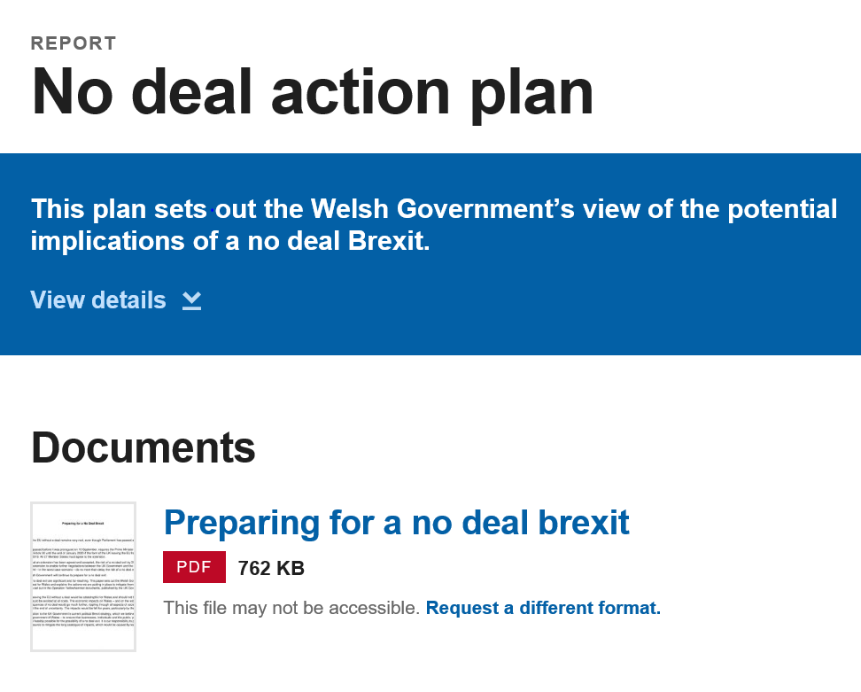
No Deal Action Plan
Skills & Individual Support
Financial and business support
https://gov.wales/no-deal-action-plan
Notes:
Our published No Deal Action Plan sets out a range of interventions and actions that support Wales’ response, addressing impacts already being felt and those we anticipate will be realised in the event of a no deal Brexit. These measures encompass our contribution to actions needed to keep transport moving through our ports as well as the essential support and advice we are providing to businesses across Wales.
Brexit effects have been felt for some time now – and will continue to impact business confidence after the point of departure. This is not just a day one issue.
But in terms of day 1 preparedness, our frontline services for businesses and individuals are ready to respond, with for example, Business Wales and the Development Bank of Wales both now positioned to mobilise human and financial resource flexibly and at pace.
Leading up to exit day, Ministers have been highlighting “low cost, no regret” actions for business. We are cascading information through business networks and have also written directly to over 18,500 businesses.
WG Action Plan: Business Readiness
We are concerned about the cumulative impacts some of our communities may be facing and how we deal with these. We have plans in place for regional response teams which will operate across the three regions set out in the EAP, and bring together WG officials as well as DWP, JCP, trade unions and other agencies
The prolonged uncertainty is compounding the acute concerns being felt by many businesses and there continues to be evidence of delayed investments, businesses moving to the EU and reticence to make business decisions.
There is continued uncertainty over employment and jobs, as well as concern over access to finance against a backdrop of wider fragility across the economy.
Ministers have written to businesses setting out steps businesses could be taking now, irrespective of the uncertainty. This went to over 18,500 businesses on the Business Wales database.
We are not formally working with the UK Government publicity campaign. However, Welsh Government has been present at recent BEIS Business Readiness Events in Wales – 14th October in Cardiff and 15th October in Wrexham.
WG Action Plan: Skills / Individual Support
The Chief Economist recognises that supporting the conditions for job creation and business success, while supporting people who cannot find work (particularly through education and training), is likely to be more effective than seeking to preserve existing industries or jobs.
Our employability support programmes are a vital part of ensuring a prosperous Wales.
From April 2020, ReAct will be replaced by Job Support Wales.
Our community employability support programmes work in some of our most vulnerable communities to help people facing complex barriers progress into work. We have identified that these communities will be the worst affected.
Our Flexible Skills Programme is supporting employers’ skills needs across Wales. We are providing £6m from the European Transition Fund for training and up-skilling the workforce in Wales’ automotive and aero-industry sectors via this Programme.
ReAct and Job Support Wales work on a well-established programme to address the needs of people who have been made redundant, or are at risk of redundancy, through a series of measures designed to remove barriers to obtaining new employment, including employer incentives to take on new recruits.
Communities for Work, Communities for Work Plus and Parents, Childcare Employment are delivered in the hearts of our most disadvantaged communities. They work with partner organisations such as local authorities and Job Centre Plus, to provide a person-centred approach, offering holistic support to tackle a range of complex barriers that participants face and helps them progress into employment.
While it is not all about numbers, a few key headlines on financial support are:
There is circa £10m available in the Economy Futures Fund created under the Economic Action Plan. Its main purpose is to assist businesses with expansion and sustainability activities, but can also be utilised to assist businesses facing difficulties.
A £4m fund to test new ways of nurturing and growing the foundation economy
Extra Capital investment - £85m for capital investment to support the economy in Wales to provide economic benefits against the ongoing uncertainty of Brexit
Supporting car and aero-industries - £6m funding for training and up-skilling the workforce in Wales’ automotive and aero-industry sectors
Financial support for businesses to prepare - £9.2m to help businesses build resilience ahead of Brexit has been made available across 6 projects: providing support and advice around trade and exports, capacity building, business confidence and resilience strengthening and offering financial support via non repayable Business Resilience grants to eligible businesses: These, non-repayable, grants have provided financial support for 51 businesses, safeguarding 886 jobs and a forecasted total of 135 new jobs being created
The interventions we are supporting with the EU Transition Fund to date includes:
£5m to support farming, food and fishing sectors post-Brexit;
£200k for research work on likely impacts and implications for social care workforce;
£150k support for the WLGA to facilitate authorities with plans and preparedness for Brexit;
£150k to support WCVA consider how Brexit will impact on community services in Wales;
£3.5m support for Welsh Universities to drive international partnerships and promote Wales as a study destination;
£6m funding for training and up-skilling the workforce in Wales’ automotive and aero-industry sectors;
£350k to partner with OECD to inform both our future regional investment approach;
A £7.5m Business Resilience scheme to aid business in Wales adapt to a post Brexit business environment.
£210k to help prepare the health service in Wales for Brexit.
£96,000 for training for veterinary surgeons so they can certify produce of animal origin exported to Wales to EU under a no deal.
150k for ADSS (Association of Directors’ of Social Services) Cymru to provide professional advice and intelligence about the potential impact of Brexit on the delivery of social care in Wales;
£590k to support preparations for successor arrangements to EU structural investment funds and implementation of a post-EU regional investment model for Wales.
£435k for Police Partnership Resilience to support the police services’ preparations for Brexit, providing dedicated capacity and capability to support local resilience forums in planning and responding to adverse scenarios and civil emergencies, particularly in the context of a no deal scenario.
£180k for UK field epidemiology – Once we leave the EU, we will lose access to epidemiology training through the European Programme for Intervention Epidemiology Training (EPIET). £180k has been awarded through the ETF to fund a place on the UK FETP in Wales, so that we can host fellows and participate in the training and network for this UK-wide programme.
£500k for Settled Status and Immigration Advice - £500k to expand the provision of information and support, including immigration advice, to help EEA citizens living in Wales and reassurance for them to apply successfully for settled status.
£500k for Local Resilience Forums (LRF) Civil Contingencies Support – we are providing £500k to help support LRFs fulfil their roles in the command, control and co-ordination arrangements for Operation Yellowhammer in Wales. Most LRFs employ just a single person to co-ordinate civil contingencies across large areas and they do not have any support to deliver out-of-hours services. £500k will enable them to increase staff numbers to co-ordinate the planning and to fulfil the reporting commitments required from them under Operation Yellowhammer. The additional staff will also provide support to any emergency response required during the period of leaving the EU when concurrent operations may be required.
£28k for building resilience in farming communities - to determine the impact of Brexit on the health and well-being of rural farming communities in Wales, and produce an evidence-based model of support co-produced with farming communities.
An extra £1.2m for local government. Up to £45,000 will be made available to each local authority in Wales, and a further £200,000 will be made available to them through the Welsh Local Government Association. The money will ensure there is a dedicated resource in each local authority to undertake the necessary planning, co-ordination and preparation work.
An additional £1.7m to help Welsh SMEs weather the challenges and uncertainties of Brexit. The money is being made available via the Welsh Government’s Business Resilience Fund, which was launched in November, with an initial invite for SMEs to bid for their share of a £1m pot.
£840,000 to reduce the scale and impact of hate crimes over two years. The funding will be shared across two strands: £360k for Victim Support Cymru to increase the capacity of its National Hate Crime Report & Support Centre; £480K for a funding scheme offering one-off grants to organisations who work with Black, Asian and Minority Ethnic (BAME) and minority faith communities to help tackle hate crime, mitigate the impact of Brexit, and provide reassurances following the EU withdrawal.

Slide 11

Economic Impacts
The Welsh economy
Businesses
Employees
Households
Consumers
Notes:
11
The Welsh Government is doing everything in our power, working with businesses and organisations right across Wales to prepare for this worst-case outcome, and protect sustainable jobs and growth.
We have ongoing and frank conversations about the impact of Brexit with businesses and their representatives. This helps us gather intelligence on their experiences and work together to prepare for the many practical implications of leaving the EU.
What matters most is securing the right form of Brexit that safeguards the economy, the jobs and the well-being of the people of Wales and indeed the whole UK.
We have consistently warned that a ‘no deal’ Brexit poses significant risks to the Welsh economy, and threatens the progress we have made in creating jobs and flourishing businesses over recent years.
The UK Government’s own estimates suggest that, with a no deal Brexit, the economy would be around 9% smaller in 15 years’ time than it otherwise would have been.
Living standards will suffer as prices at home and the cost of travel abroad increase as a result of devaluation and tariffs.
This is on top of the damage which has already been done, with the Bank of England estimating that every person in Wales is already £1,000 worse off than they would have been as a result of Brexit uncertainty.
The people most likely to be adversely affected are those who are already most disadvantaged in labour market terms (particularly those with poor skills, disability or illness).
The places most at risk are those with high concentrations of such people, particularly where the wider economy is less resilient.
It is virtually certain leaving the EU without a deal or transition period will produce a severe economic slowdown in the UK, with, in the worst case, a recession that approaches in depth the one experienced in 2008-09. A slowdown of this magnitude might mean a reduction in Welsh employment equivalent to 40-50,000 jobs.
While certain sectors of manufacturing and agriculture will suffer particularly from specific initial shocks associated with new trade barriers, the lesson of previous recessions is that the largest negative effects are likely to be experienced by the construction industry, consumer-facing services and those sections of manufacturing most exposed to consumer and investment demand.
The economy in Wales is likely to be up to around 10 per cent smaller than otherwise over the long term, depending on the nature of new trading relationships that are introduced over time and the speed of adjustment to those new relationships.
There are many different sources of analysis. One interesting piece is the Brexit Scorecard produced by The UK in a Changing Europe. This group promotes rigorous, high-quality and independent research into the complex and ever changing relationship between the UK and the EU. It is funded by the Economic and Social Research Council and based at King’s College London. This report looks at issues such as the impact of Brexit on public finances.
The report highlights the importance of productivity, the authors say “The overall impact of Brexit on the UK economy will therefore depend primarily on what happens to productivity. So far, there is little sign of any improvement: output per hour actually fell in the first quarter of 2019. Nor is there much evidence that the persistent weaknesses (in the UK economy) are being addressed in any meaningful way. Business investment, an important driver of productivity over the longer run, fell in 2018, due at least in part to Brexit uncertainty.”
In October Make UK the Manufacturers Organisation published their 3rd Quarter Manufacturing Outlook report. The report says that
“Both domestic and export orders have contracted this quarter, for the third quarter in a row. At the very time we need to be trading more, our survey results and members reports indicate that foreign customers are abandoning their British suppliers to Brexit uncertainty and this is having knock-on consequences for domestic demand as well.”
“Members expect UK demand to remain in negative territory next quarter as order books continue to shrink and they are also anticipating another decline in export demand from foreign customers.”
“Investment in technology and skills training – the real engines of economic growth – has been paralysed all year but worryingly investment intentions have now entered negative territory for the first time since Q3 2016 (the period immediately following the Brexit referendum).”
Consequences of a No-Deal Brexit
A no-deal Brexit means that the U.K. would no longer be a member of the EU and it would have no trade agreement. It would eliminate Britain's tariff-free trade status with the other EU members.
Tariffs would raise the cost of exports. That would hurt exporters as their goods became higher-priced in Europe. Some of that pain would be offset by a weaker pound, but that is not a straight forward equation!
Tariffs would also increase prices of imports into the U.K. One-third of its food comes from the EU. Tariffs are as high as 74% for tobacco, 22% for orange juice, and 10% for automobiles. Higher import prices would create inflation and lower the standard of living for U.K. residents.
A hard border would require all imports to go through customs. Delays at the border could create food shortages in the short term and considerable complexity and problems for those who operate Just In Time supply chains.
Consequences of a Hard Brexit
A hard Brexit is like a no-deal Brexit but would include a trade agreement.
A hard Brexit could be damaging to The City, the U.K.'s financial centre. The City of London reported that 5,000 jobs could be lost. Housing prices have already started to fall in London and many businesses have already left or set up operations in the EU. The City's reputation as a bastion for business by be permanently damaged.
The United Kingdom would lose the advantages of the EU’s state-of-the-art technologies. The EU grants these to its members in environmental protection, research and development, and energy.
Also, U.K. companies could lose the ability to bid on public contracts in any EU country. These are open to bidders from any member country. The most significant loss to London is in services, especially banking. Practitioners could lose the ability to operate in all member countries. A hard Brexit could raise the cost of airfares, the internet, and even phone services.
A hard Brexit would also hurt Britain's younger workers. Germany is projected to have a labour shortage of 2 million workers by 2030. Those jobs will no longer be as readily available to the U.K.'s workers after Brexit.
London has already lost many nurses and other health care professionals. In the year following the referendum, almost 10,000 of them quit. The number of nurses from Europe registering to practice in Britain has dropped by almost 90%.
£100m Life Sciences Fund & Innovation Hub.
£74m Public Sector Broadband Aggregation Network.
£50m Ser Cymru (Star Wales) Programme.
£40m High Performance Computing Wales.
£9m Foundation Wales.
£5m Alacrity Programme.

Slide 12
Wales’ Economy
Wales’ economy – gva by sector
Source: Stats Wales
Notes:
Story of slide – top 4 sectors by GVA WALES public admin, production, wholesale, retail, real estate
Definition of GVA - gross value added (GVA) is the measure of the value of goods and services produced in an area, industry or sector of an economy. In national accounts GVA is output minus intermediate consumption; it is a balancing item of the national accounts' production account.

Slide 13
Trade in goods
Top 3 countries for UK exports – Germany, France & USA
Top 3 commodities exported – machinery and transport equipment, mineral fuels lubricants and related materials, manufactured goods classified chiefly by material.
Machinery and Transport is by far the largest category of goods exports from Wales and accounted for 49.6% of exports by value in 2018. Of these exports, 63% were to the EU.

Slide 14
Real impacts
“Both domestic and export orders have contracted this quarter, for the third quarter in a row. At the very time we need to be trading more, our survey results and members reports indicate that foreign customers are abandoning their British suppliers to Brexit uncertainty and this is having knock-on consequences for domestic demand as well.”
Make UK – 3rd Quarter 2019 Manufacturing Outlook Report
Notes:
In October Make UK the Manufacturers Organisation published their 3rd Quarter Manufacturing Outlook report. The report says that
“Both domestic and export orders have contracted this quarter, for the third quarter in a row. At the very time we need to be trading more, our survey results and members reports indicate that foreign customers are abandoning their British suppliers to Brexit uncertainty and this is having knock-on consequences for domestic demand as well.”
“Members expect UK demand to remain in negative territory next quarter as order books continue to shrink and they are also anticipating another decline in export demand from foreign customers.”
“Investment in technology and skills training – the real engines of economic growth – has been paralysed all year but worryingly investment intentions have now entered negative territory for the first time since Q3 2016 (the period immediately following the Brexit referendum).”

Slide 15
Trade in services
In 2017, services accounted for 71.4% of Welsh GVA, valued at £44.4bn.
In 2018, 1.13 million people were employed in service industries in Wales.
The majority of these were within Professional Business Services (including legal services, consultancy, accountancy, and customer services) 4.5% of Welsh economy.

Slide 16
Wales - people and skills
Overcoming hard to fill vacancies
Most businesses have not tried to recruit overseas workers – of the 32% businesses that have over half (51%) recruited EU nationals only.
Overcoming skills gaps
Most businesses have not recruited or tried to recruit non UK nationals - of the 13% that have, over half (55%) recruited EU nationals only.
Notes:
European Funding continues to play a highly significant role across Wales and we understand that many businesses are concerned about the impacts that may arise from Brexit.
In July 2018, the UK Treasury Guarantee was extended to meet any funding commitments to projects made before the end of December 2020, even if the payments fall beyond December 2020 but before 2023; and to guarantee payments at current cash levels under the CAP until the end of the current Parliament in 2022.
While this provides some financial security over the short-term, there is none over the medium term. The UK Government has refused to provide any assurance about levels of agricultural funding or the methodology for allocating it after 2022, with the risk that a UK Government might a) reduce the level of funding across the whole UK and/or b) reduce Wales’ share of UK agriculture funding. This would be deeply worrying given that Wales currently receives just under 10% of CAP funding to the UK, significantly greater than our overall share of the UK population as a whole, because of the large proportion of marginal land in Wales.
In the case of regional economic investment to replace the ESIF, the situation is even more unsatisfactory. The Conservative Manifesto in 2017 pledged the introduction of a UK wide Shared Prosperity Fund, with this pledge subsequently followed by promises that a consultation would be launched by the end of 2017 and, when that was delayed, by the end of 2018.
Despite considerable pressure from the devolved governments and from other stakeholders, there is still no clarity and no meaningful engagement in preparing the proposed consultation on successor arrangements. UK Government Ministers, have however suggested by‑passing the Welsh Government, which would undermine our devolution settlement.
EU Funding
Many small businesses directly or indirectly benefit from EU funding. The UK Government has provided a guarantee of funding for all of the below:
The full 2014 - 20 Multiannual Framework (MFF) allocation for Structural and Investment Funds (ESIF) and European Regional and Development Funds (ERDF). New bids for funding under the ERDF, ESF (European Social Fund) and European Territorial Co-operation Projects, post exit day will be guaranteed by the Government until the programme closes at the end of the MFF.
The payment of awards where UK organisations successfully bid directly to the European Commission (e.g. through projects such as Horizon 2020) on a competitive basis until the end of 2020.
The payment of awards for successful bids where the UK organisations are able to participate as a third country in competitive grant programmes from exit day until the end of the programme. This includes the SME instrument in Horizon 2020.

Slide 17

Welsh - Inward Investment
Foreign Direct Investment down
Supply chain impacts
International Strategy – consultation closed
UK/Japan trade deal - consultation live – 4 November
https://www.gov.uk/government/consultations/trade-with-japan
Notes:
The uncertainty caused by Brexit has already had an adverse effect on levels of inward investment into Wales, as well as the wider UK, with overall numbers declining since 2016.
The pipeline of future opportunities is seeing significant shrinkage and a number of high profile multi-national companies have cited Brexit as one of the reasons for questioning the future of their UK sites. Despite this, in 2018-19, we managed to land 51 projects and 3,704 jobs, 75% of which were linked to Welsh Government intervention.
A strong UK market with tariff-free access to the much larger EU single market has been one of the main reasons cited by non-EU companies who have chosen to invest in Wales. This loss of access will have a major bearing on future investment decisions for new and existing investors alike.
The potential loss/downsizing of existing foreign owned companies in Wales will have an impact on employees directly employed at the site as well as the wider supply chain, including Welsh-owned SMEs.
International Strategy:
OUR THREE KEY GOALS ARE TO:
Raise Wales’ profile internationally – we will build our nation’s reputation as a place buzzing with creativity where people are free to innovate and experiment.
Increase our exports and encourage inward investment, growing our economy and creating new jobs and opportunities for people in Wales – we are committed to embracing and developing new technology to deliver prosperity.
Show the world what we are doing as a globally responsible nation – Wales is acutely aware of its global and environmental responsibilities. Our strong values of sustainability underpin this strategy and everything we do.
The International Strategy proposes to promote Wales’ capability in three areas: cyber security; compound-semiconductors; and, the creative industries (film and TV). The aim is to showcase areas of our economy where opportunities and world class expertise already exist in Wales and there is a solid basis on which we can build in the face of the challenges posed by Brexit.
The use of ‘magnet’ projects, which have the potential to act as catalysts for attracting future investment in a region, is also set out in the strategy as a means to counter the decline in inward investment.
We will continue our focus on creating and promoting world-class facilities for business growth in Wales, using “magnets” as opportunities for businesses and as a means to elevate Wales’ reputation for our assets, skills and research and development capability.
“Magnet” projects, such as the Advanced Manufacturing Research Centre Cymru, in North Wales; the Global Centre of Excellence for Rail and the UK Catapult Centre, in South Wales and the new International Convention Centre, in Newport, will be used as catalysts to attract further investment and will promote Wales as a test bed for future cutting-edge technologies.5

Slide 18
What has Welsh government to prepare wales – brexit Resilience PROGRAMME
Export support – pan Wales network of WG export advisers & tailored programme for Welsh businesses including trade missions
Collaboration – cross public sector
International presence – new overseas offices / consultation on new International Strategy
Trade Survey Wales – sent to 8,000 businesses in Wales
Marketing business support – selling Wales in the world
Business Resilience Grant – practical support, now closed
Notes:
Over and above pre-existing business support and programmes, the Welsh Government has been investing additional resources in preparation for Brexit. On the business and economy side of the house we competed and secured some of that funding and have been using the resource made available from the EU Transition Fund to address six key challenges:
The first challenge has been to support more Welsh businesses to develop the skills and confidence necessary to become exporters or grow their export trade. We have used funding to increase the capacity of our highly regarded export service so that we can work with more companies. Allied to this we have invested to ensure Businesses have access to the high quality intelligence and technical information and advice necessary to successfully develop new export opportunities.
The second challenge has been to work with businesses where short-term support is required to overcome or address specific and pressing Brexit related obstacles. [IF COVERED EARLIER THEN MOVE ON TO NEXT POINT]
Our Brexit Resilience Grant has been providing an additional, flexible funding route that allows Welsh Government to invest with businesses as they seek to overcome Brexit related challenges where existing funding options are not an appropriate for sufficiently flexible fit.
The third challenge facing some businesses is to find new ways of collaborating and working together so that together they can capitalise on new opportunities or mitigate shared risk in the context of new trading arrangements. So, as part of our Brexit Resilience offer we have been setting aside resource that is allowing us to work with businesses to explore new forms of collaboration, joint venture, innovation or collective capacity building such as may be necessary to underpin future competitiveness and retain jobs and growth in Wales. [This work has centred on the Nuclear Sector to date]
The fourth challenge is that of doing all we can to sell Wales in the world. We believe that the Welsh Government has a legitimate role to play in supporting business to reach out and sell to the world as well as strengthening the visibility of Wales as a destination for trade and investment.
We have therefore utilised funding from the EU Transition Fund to support campaigns and activities with business that help companies establish the traction they need in new markets and that positions us to keep Wales’ international profile as a location for investment strong and positive.
Fifth, we are using this funding to invest to enhance our overall understanding of the trade flows between Wales and the rest of the UK and beyond.
Welsh Government have commissioned IFF Research to undertake the first Trade Survey for Wales, funded by the European Transition Fund - Business Resilience (MA-P KS 3346-18), which will be launched w/c 21st October 2019.
8000 businesses located in Wales will be invited to participate in the online survey, they will be encouraged to complete by the middle of November, although the survey will remain open for completion until the 20th December 2019
There are currently no directly measured trade statistics for Wales; the Trade Survey for Wales is the first data collection exercise of its kind
The data from the survey will enable Welsh Government to quantify the trade flows in and out of Wales for goods and services, and will seek to quantify the amount of trade between the constituent parts of the UK
Better data will inform better decision-making, both as we consider our response to Brexit in the short-term and as we develop the frameworks and mechanisms necessary to support the effective working of the UK internal market into the future.
Finally, because of the uncertainties and the changes Brexit brings – we are seeing more businesses wanting to engage with Welsh Government. The visibility of our business support offer is therefore critical and that is why we are have set aside funding to more vigorously connect businesses in Wales with the range of support services already available through Business Wales and other offers.

Slide 19

Welsh government Business SUPPORT – financial & non financial
Accessed via Welsh Government Regional teams (North, Mid & South West and South East Wales)
Welsh Government repayable business finance
Sector specific support – food, tourism, creative, environmental
Skills support
Accessed via Development Bank of Wales (DBW)
Over £500m available to invest in Welsh businesses
Loan and equity based finance, £1K - £5m.
Notes:
We recognise how vital it is that we orchestrate a coordinated, sustainable approach where businesses and their employees face downsizing and or redundancy events. Drawing on lessons learned from past and present interventions, going forward our response is being led on a regional basis – aligning with the regional economic development model set out in the Economic Action Plan.
To provide for the effective handling of business closures, relocations or downsizings resulting in significant regional or national implications, Regional Response Teams with a supporting secretariat have been established for each region (i.e. North, South-East, and South West and Mid).
The Regional Response Teams will be playing a role in :
Identifying the direct and indirect impacts of Brexit on the jobs market;
Identifying and co-ordinating existing social and economic support structures and programmes that will contribute to the wellbeing of the regions;
Orchestrating support to workers and their families who are directly and indirectly affected by unfavourable labour market changes (jobs, health, wellbeing, financial stability) and
Provide intelligence and advice on key factors such as wages, conditions of employment, job locations, under employment, distribution of unemployment/redundancies, polarisation of jobs and equality within the labour market.

Slide 20

Business wales support for business –financial & non financial
Accessed via Business Wales website or 03000 6 03000
Business Wales – SME support – face to face advice, workshops and funding
Brexit support now fully committed - Brexit Resilience Fund
www.businesswales.gov.uk
/
Notes:
Business Support
The Welsh Government is committed to supporting SMEs across Wales which is why we are investing £86m up to 2020 in our European funded programme, Business Wales, to ensure entrepreneurs and SMEs have access to the information, advice and support they need to help them start, grow and prosper.
The latest phase of Business Wales’ work aims to create 10,000 new businesses, 28,300 new jobs and provide support to help inspire the next generation.
Business Wales offers a single point of contact for businesses and entrepreneurs to advice and support from public, private and voluntary sectors, and can be accessed online via http://businesswales.gov.wales and associated social media channels; the 03000 6 03000 helpline; and a network of offices located across Wales.
The helpline operates Monday to Friday between 8:30am and 5:30pm
Proposed extended opening hours from 31 October to 15 November (in if the UK leaves the EU in a no deal scenario):
Monday to Friday – 8:30am to 9:00pm
Saturday – 9:00am to 5:00pm
Sunday – 10am to 4:00pm
Business Wales offers a combination of online, telephone, 1-2-many and 1-2-1 business support which is tailored according to client need and the different regions of Wales, dependant on local requirements.
Business Wales provides general business advice, information and signposting, as well as 6 specialist strands including equality & diversity; resource efficiency; international trade; skills; procurement; and mentoring. In addition to broadband exploitation and access to the Skills Gateway and Farming Connect.
Business Wales delivers practical support for businesses wishing to tender to the public sector including Meet the Buyer and How to tender workshops.
Business Resilience Fund [NOTE FUND IS NOW CLOSED TO NEW APPLICATIONS]
Launched in November 2018, the Business Resilience Fund allowed businesses, in particular SMEs, from across Wales to bid for between £10,000 and £100,000 of Welsh Government funding, to a maximum of half the project costs (including capital and revenue expenditure), to support them as the UK prepares to leave the European Union.
Our Business Resilience Fund has helped businesses, in particular SMEs, prepare for and navigate the challenges of Brexit. The fund is being delivered via the Business Wales service with ‘wrap-around’ advice and support to complement funding including via the Brexit Portal and self-assessment tool.
There has been strong interest in the fund. Because of shifting deadlines and the real risk of no deal at the end of October consideration is again now being given to the option of further extending this valued support mechanism. This is a relatively small fund, and it cannot mitigate the negative impacts of Brexit, but it can where justified, support some businesses in meeting very immediate Brexit related challenges.

Slide 21
RESOURCES
Business Wales Brexit Portal: https://businesswales.gov.wales/brexit/
Paratoi Cymru / Preparing Wales: https://beta.gov.wales/preparing-wales
Get ready for Brexit: www.gov.uk/brexit
Reporting technical barriers to trade – https://www.great.gov.uk/report-trade-barrier/
UK Government UK/Japan trade deal consultation - https://www.gov.uk/government/consultations/trade-with-japan
Notes:
Slide notes
Press ‘1 + Enter’ to return to the home/cover slide.
A little bit of background on Wales.
How we can work closely with companies on inward investment and trade.
The fantastic support packages available to international businesses.

Slide 22
QUESTIONS

Slide 23
Contact details
Ruth Bacigalupo
Ffôn / tel : 0300 025 3117 / 07917 531673
Ebost / email – ruth.bacigalupo@llyw.cymru / ruth.bacigalupo@gov.wales
Notes:
We recognise how vital it is that we orchestrate a coordinated, sustainable approach where businesses and their employees face downsizing and or redundancy events. Drawing on lessons learned from past and present interventions, going forward our response is being led on a regional basis – aligning with the regional economic development model set out in the Economic Action Plan.
To provide for the effective handling of business closures, relocations or downsizings resulting in significant regional or national implications, Regional Response Teams with a supporting secretariat have been established for each region (i.e. North, South-East, and South West and Mid).
The Regional Response Teams will be playing a role in :
Identifying the direct and indirect impacts of Brexit on the jobs market;
Identifying and co-ordinating existing social and economic support structures and programmes that will contribute to the wellbeing of the regions;
Orchestrating support to workers and their families who are directly and indirectly affected by unfavourable labour market changes (jobs, health, wellbeing, financial stability) and
Provide intelligence and advice on key factors such as wages, conditions of employment, job locations, under employment, distribution of unemployment/redundancies, polarisation of jobs and equality within the labour market.

Slide 24
Business support Funding
Grants | Business Wales support, Brexit Resilience Grant, Flexible Skills Programme, Export and Trade support, Food sector grant, Property Development grant, Rural Development Plan (support for community and micro businesses) | General support schemes to help businesses thrive and grow: encouraging R&D, company wanting to invest but unable to find full sum, prevent high value disinvestment.
Loans and equity | Development Bank of Wales (DBW) | Suite of financial loan and equity products available e.g. Wales Flexible Investment Fund (deal range £25K-£5m) maximum loan term 10 years; Wales Micro Loan Fund (deal range £1K-£50K), loan, maximum loan term 10 years; Wales Capital Growth Fund (working capital), £50K-£2m, loan, maximum loan term 18 months; Wales Business Fund (deal range £50K-£3m), loan and equity, maximum loan term 5 years; Other funds (£35K-£3m) loan and equity, maximum loan term 10 years; Residential and Commercial Property Funds (deal range £100K-£4m), loan, maximum loan term 5 years.
Repayable Business Finance – Economy Futures Fund | 1. Capital Investment and Job Creation 2. RD&I support 3. Tourism Investment Support (TISS) 4. Creation Production Funding for Film and Television, 5. Environmental Support Scheme, 6. Repayable Fund for SMEs. | Run directly through Welsh Government. Predicated on business growth and investment aligned to the Economic Action Plan Calls to Action.
Notes:
This slide highlights the range of grants, loans and equity and repayable business finance solutions currently being managed by the Welsh Government. There is a lot of detail here and this is not the place to unpack all the details. However, the point I want to make here is that the Welsh Government is working with businesses across Wales, utilising a range of levers and mechanisms to promote jobs, growth and business success.
If you don’t already have a relationship with a Business Development Manager or Account manager then I would encourage you to make those links.
The Welsh Government has a proud tradition of working with business.

Slide 25
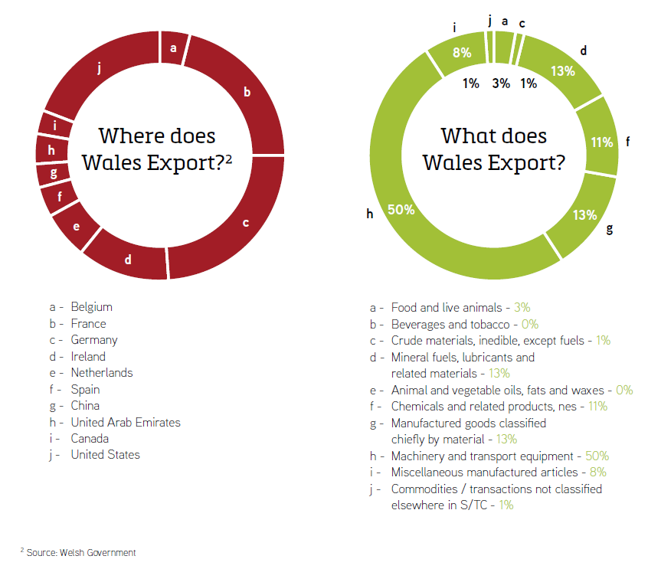
  input
Notes:
Slide notes
Press ‘1 + Enter’ to return to the home/cover slide.
A little bit of background on Wales.
How we can work closely with companies on inward investment and trade.
The fantastic support packages available to international businesses.

Slide 26
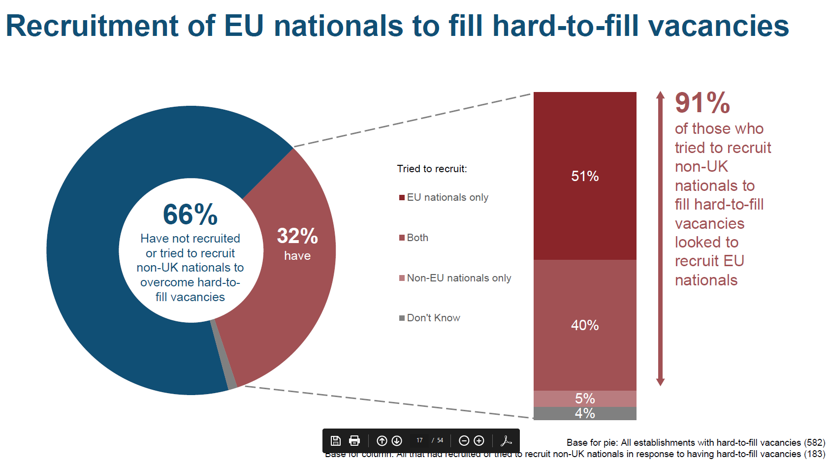
Notes:
This slide highlights how around one third of businesses surveyed as part of the 2017 Employer Skills Survey used the recruitment of EU nationals to fill hard –to-fill vacancies. This underlines the importance of free movement that Welsh Ministers have been advocating throughout the Brexit process.
The Home Office is a key source of advice on mobility and Welsh Government is taking every opportunity to engage with both the Home Office and the Migration Advisory Committee, making the case that proposed new arrangements for a £30k salary cap are inappropriate for Wales.
[PORTAS REPORT]
The Welsh Government is acting to support EU citizens
On 9th July Welsh Government announced a new package of support to help EU citizens prepare for Brexit and continue to live and work in Wales.
Around 80,000 EU citizens currently live, work and study in Wales and many have not yet applied to the UK Government’s Settlement Scheme to remain in the UK after Brexit.
The new package of support from Welsh Government will:
Offer support with applications and give advice on social welfare issues and workplace rights through the network of Citizens Advice throughout Wales;
Provide an immigration advice service offering specialist support for complex cases, delivered by immigration legal specialists, Newfields Law;
Increase the provision of digital support centres in Wales – to help those without the digital means to apply for settled status;
Work with a range of charities and partners across Wales to raise awareness of the need to apply for settled status in hard-to-reach and vulnerable communities.
The Welsh Government want all EU citizens living and working in Wales to stay here and to know that they continue to be welcomed and appreciated for their contributions to Welsh life.
All EU citizens who wish to remain in Wales must apply for settled status, by December 31st 2020 if we leave with no deal, or by June 30th 2021 if we leave with a deal.
Welsh Government is backing extra support for EU citizens in Wales to make sure they are aware of their rights and the steps they need to take to stay.
The support will offer a package of various levels of advice, from basic help with digital support, basic support/general advice on applying for the EUSS, outreach support for minority communities, up to specialist free legal immigration advice.

Slide 27
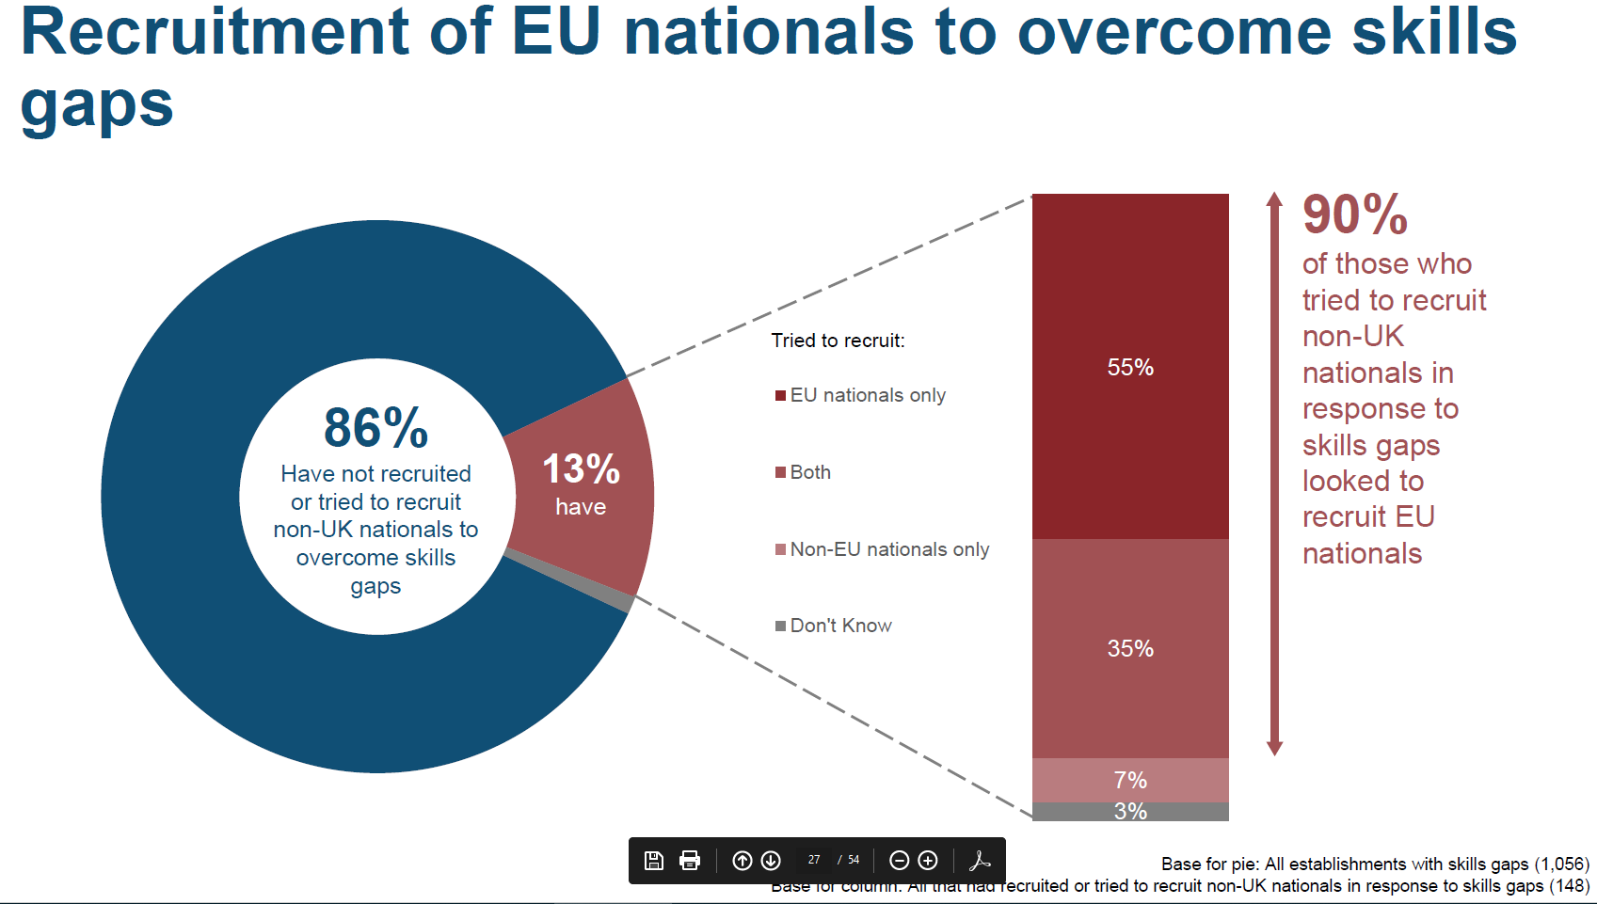
Notes:
This slide looks at the recruitment of EU nationals to overcome skills gaps (rather than hard to fill vacancies). These are significant numbers and show that many businesses are looking to the skills of EU nationals to grow and develop their businesses.

Slide 28
Welsh Services exports 2016
ONS experimental statistics show Welsh service exports to be worth £5.6bn in 2016.
Functional category | Value of service exports (£m) | Percentage category makes of total (%)
Insurance and pension services | 1,445 | 26
Manufacturing | 1,171 | 21
Financial | 1,012 | 18
Travel | 709 | 13
Transport | 577 | 10
Information and communication | 271 | 5
Real estate, professional, scientific and technical | 257 | 5
Administrative and support services | 62 | 1
Primary and utilities | 28 | 1
Wholesale and motor trades | 27 | 1
Retail (excluding motor trades) | 19 | 0
Construction | 13 | 0
Other services | 11 | 0
Total in all categories | 5,604 | 100
Notes:
Story of slide – Welsh services exports – top categories insurance and pension services (where most people employed), manufacturing and fniancial

