Slide 1

Brexit update
24 Oct 2019
Michael Warren
BIA Brexit Lead

Slide 2
What could happen by Oct 31st?
Deal
No Deal
Delay

Slide 3
The new Withdrawal Agreement shifts further away from EU alignment
Keeps the old transition period
  transition period up to the end of 2020 (possibly extended up to the end of 2022) during which the UK remains in essentially the same economic relationship with the EU as now
  Intention to maintain close alignment remains in the Political Declaration
“The parties will also explore the possibility of cooperation of the UK authorities with Union agencies such as the European Medicines Agency”
Now the focus is on a FTA
  During transition UK and EU negotiate the terms of their future relationship. The type of trade agreement sought by the UK is now different and looser than under the previous deal.
  Under the previous deal, if no new trade deal was agreed, the ‘backstop’ would have kicked in after the transition period. This meant the whole of the UK would have been in a customs union with the EU
  If a trade deal is not agreed by the end of the transition period, the default position is that Northern Ireland applies many EU rules (subject to a consent mechanism) but the rest of the UK would move to a no-deal/World Trade Organization (WTO) relationship

Slide 4
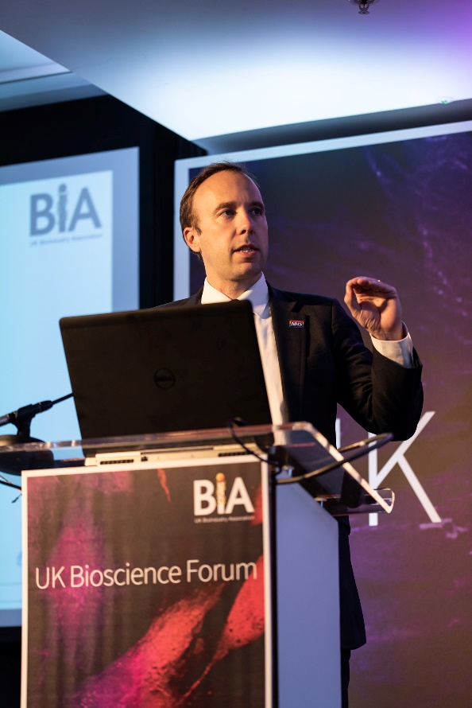
Govt is aiming for close co-operation with EU on regulation
The new deal sets a FTA as the destination at the end of the transition period
“regulatory collaboration” and “active participation” with the EMA were set out by Matt Hancock as the government’s preferred position at the Bioscience Forum
This would be subject to negotiations with the EU about the terms of an FTA
“mutual recognition of products produced in the U.K. and the EU”
Matthew Hancock, Bioscience Forum 17 Oct 2019

Slide 5
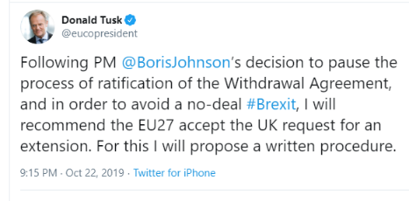
The big political issues in play
European Council is deciding on an extension, following Tusk’s recommendation to accept the UK’s proposal
Potential revised timetable for the WA Bill, or govt push for General Election
Mixed messages from opposition on whether they will agree to an election
A short, technical extension?
Withdrawal Bill un-paused
General Election?
A longer extension?
2nd referendum?

Slide 6
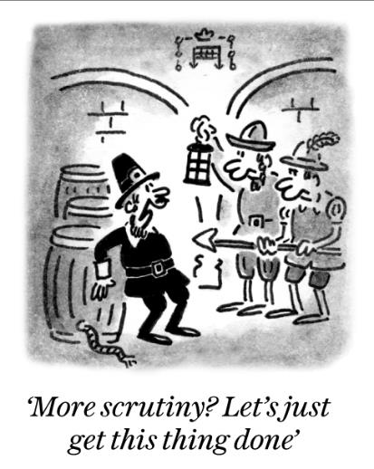
Can the deal succeed relatively intact?
PM has a agreed by the EU and in principle by Parliament, but many objections remain on the detail
If the Bill is ‘un-paused’, amendments could ‘neutralise’ the politically sensitive elements, such as
  Full UK alignment to EU Customs Union
  Second referendum required before ratification
  Parliamentary ‘lock’ on extension beyond Dec 2020
If any amendments succeed, the govt is likely to withdraw it again and try to call a General Election
The opposition parties’ positions on second referendum versus General Election become decisive at that point

Slide 7
No deal is still possible
A decision from the EU on an extension is expected today
The Benn Act mandates acceptance of a delay, if offered
“If the European Union decides to agree an extension of the period in Article 50(3) of the Treaty on European Union ending at 11..00pm on 31 October 2019 to the period ending at 11.00pm on 31 January 2020, the Prime Minister must, immediately after such a decision is made, notify the President of the European Council that the United Kingdom agrees to the proposed extension”
But it is still technically possible that the EU may not agree to grant an extension, as all member states have a veto
Alternatively, if an extension other than to 31 January is offered, the government could bring forward a motion in Parliament, as prescribed by the Benn Act…
“That this House has approved the extension to the Period in Article 50(3) of the Treaty on European Union which the European Council has decided”
… which could be voted down by MPs, resulting in a no deal exit on 31 October

Slide 8
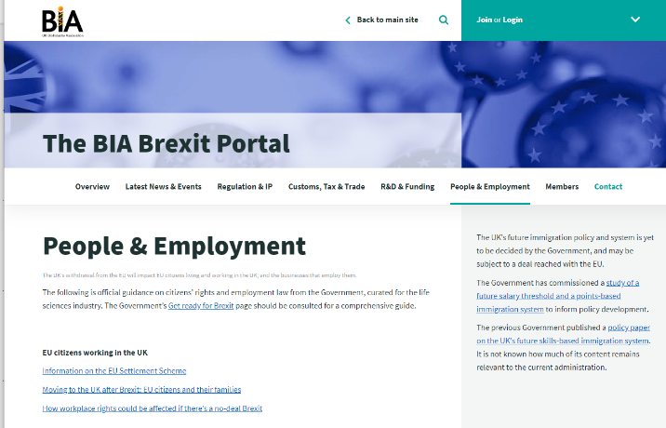
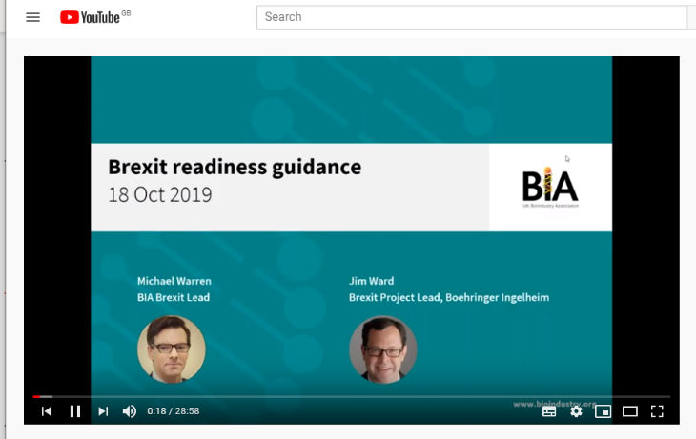
BIA Brexit readiness programme
Our Brexit portal has links to all the latest advice and resources
Our previous webinars and briefings are all on our BIA Youtube channel
We will use your feedback and questions to challenge and seek additional clarity where necessary. Contact us at: biabrexit@bioindustry.org

Slide 9
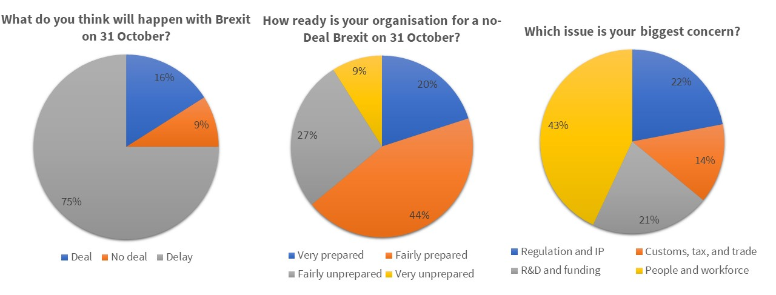
Key issues emerging
We’ve held events in Oxford, Cambridge, Leeds, Liverpool, Newcastle, Manchester, Edinburgh
Most now think there will be a delay
Many businesses are either part prepared or not at all prepared
Debate and questions, particularly on: Batch testing/regulation/clinical trials; People and employment; border arrangements

Slide 10
Thank you
BioIndustry Association
  Southside
  7th Floor
  105 Victoria Street
  London
  SW1E 6QT
    Email: biaevents@bioindustry.org

