Slide 1
®
The Life Science Network for Wales
Debbie Laubach
MediWales

Slide 2
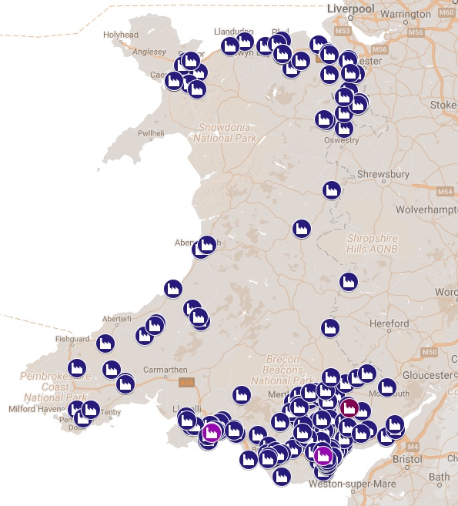
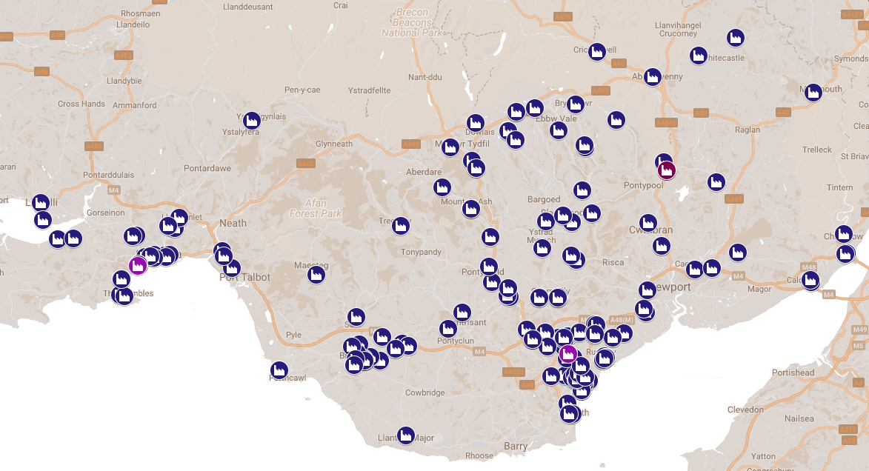
Welsh Life Science
370 Companies, 11,000 people, >£2bn pa
Notes:
The South Wales Health Innovation Corridor is a major cluster of 251 life science companies (87% of Welsh life science companies). The cluster has a combined turnover of £2.5bn and employs over 9,000 people in high value, research led businesses serving global growth markets.

Slide 3
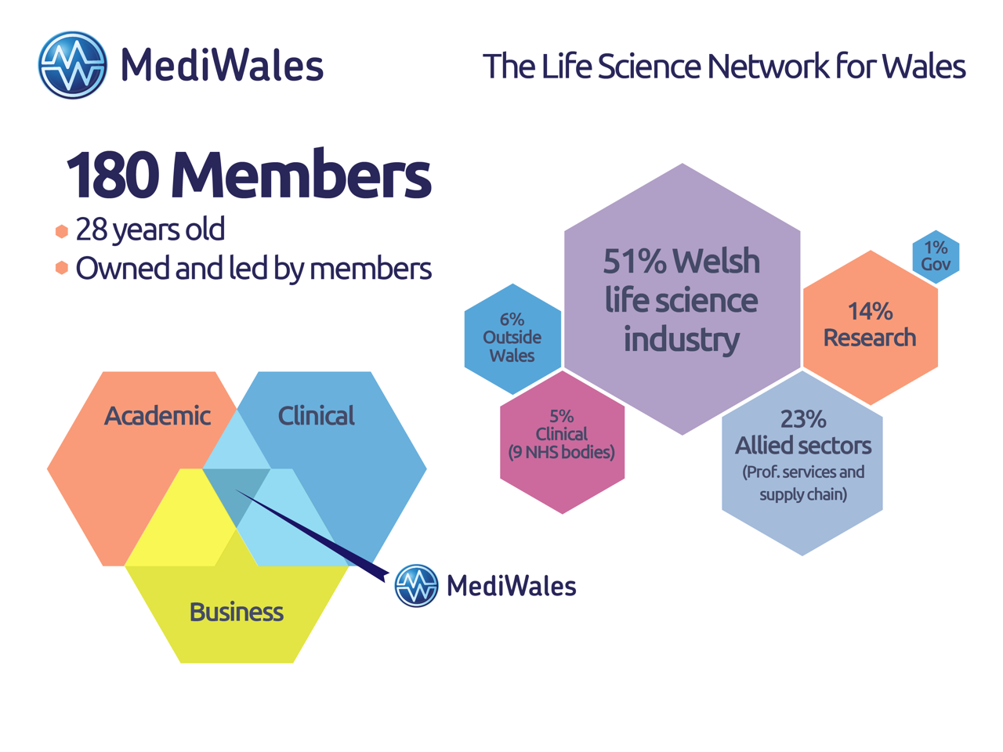

Slide 4


Slide 5
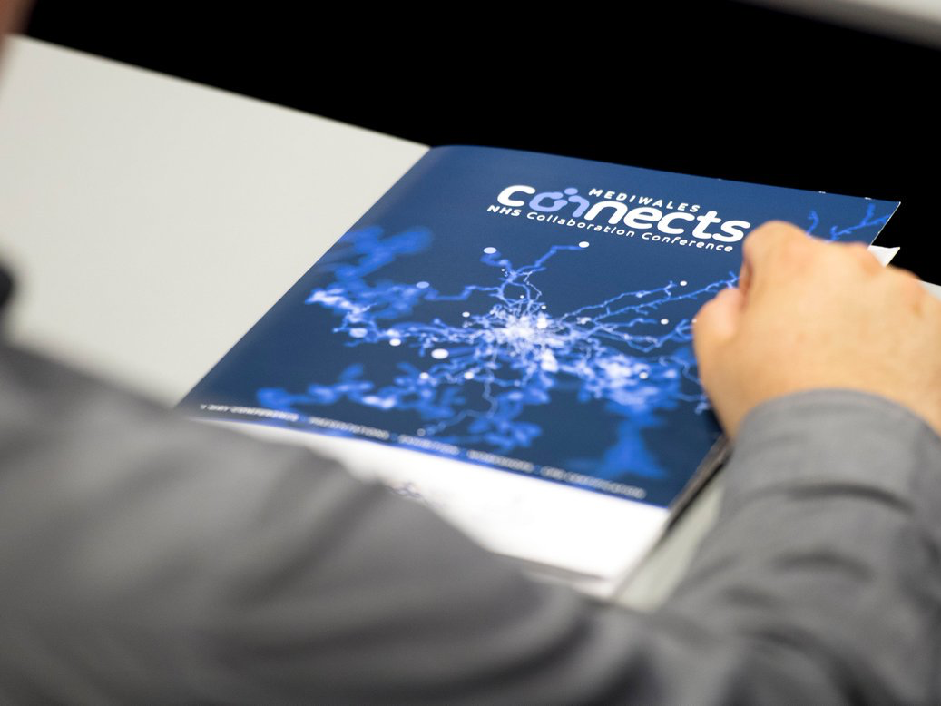


Collaborate

Slide 6


Communicate

Slide 7

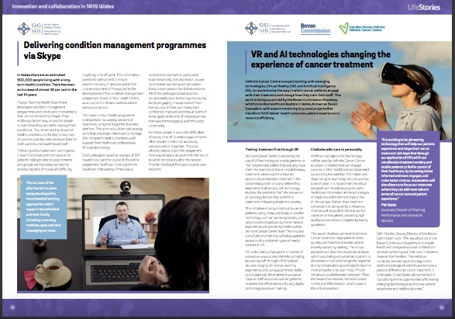
Inform

Slide 8


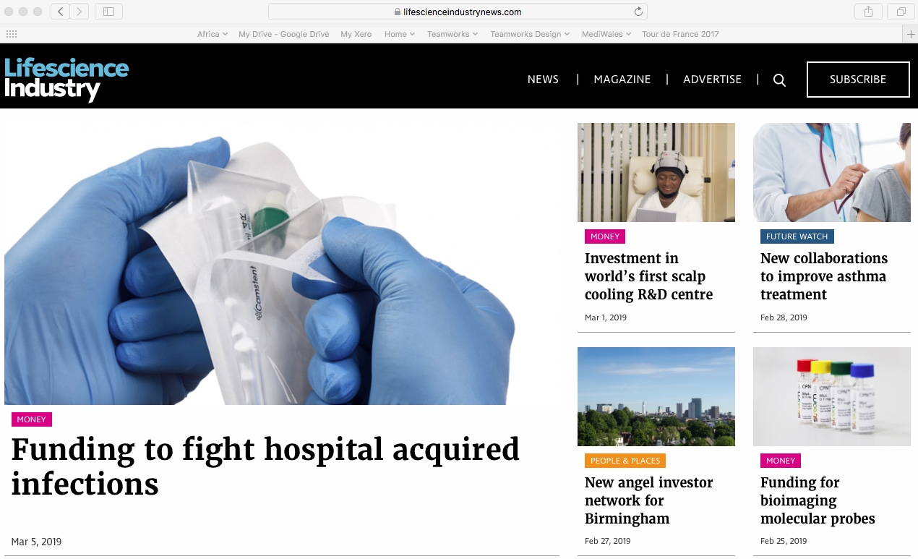
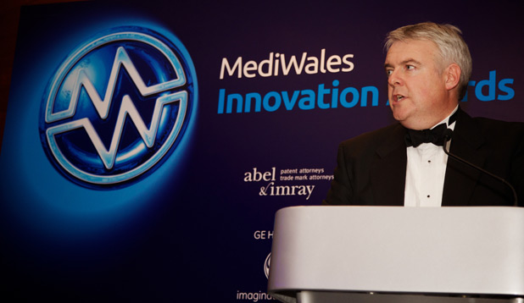
UK wide event 300 delegates
UK publication 40,000 distribution
Online support 30,000 visits pa
Annual Awards in partnership with NHS Wales 300 + delegates

Slide 9
Thank you
Debbie Laubach
MediWales

