Slide 1



Enterprise Europe Network
Lawson Coombes – (Innovation Specialist)
24th October, 2019

Slide 2
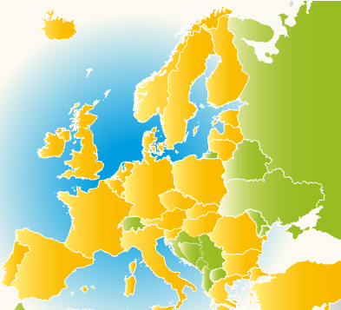
Enterprise Europe Network
“Enterprise Europe Network is the key project by which the European Commission is helping small businesses to innovate and succeed in the increasingly competitive global economy”

Slide 3
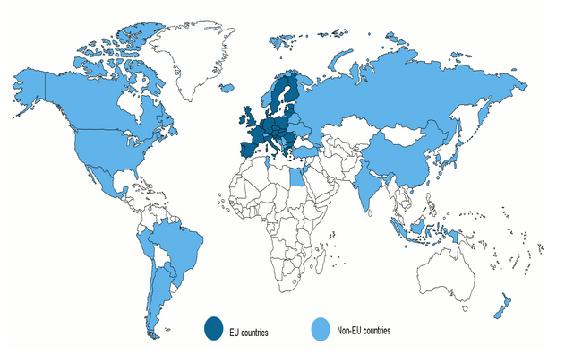
Including:
BRIC
MIST
600 partner
Organisations in
68 countries with
4000 local experts
Notes:
The Network’s resources are formidable.
It’s made up of 581 partner organisations in 48 countries.
The partner organisations include chambers of commerce, enterprise agencies, regional development organisations, research institutes, universities, technology centres and innovation centres.
3,000 experts work in the Network.

Slide 4

Enterprise Europe Network Wales
What we do...
Trans-national business matchmaking for commercial growth and supply chain expansion
Enable technology transfer
Increasing volume of R&D funding attracted
Supporting participation in Brokerage Events
Providing information on commerce, legislation, finance and taxation in the EU

Slide 5


Support for commercial and business development
Identifying clients’ commercial needs / offers then finding suitable partners for:
product distribution or sales agency
supply chain development
JV, merger or franchise agreement
company sale or acquisition
transport / logistics
subcontracted or reciprocal production

Slide 6


Support for innovation and technology transfer
Identifying clients’ technology needs/offers then finding suitable partners for:
IP licensing agreement
technical cooperation to adapt / develop
joint ventures based on technology
commercial agreement with tech support
manufacturing agreement inc. expertise

Slide 7
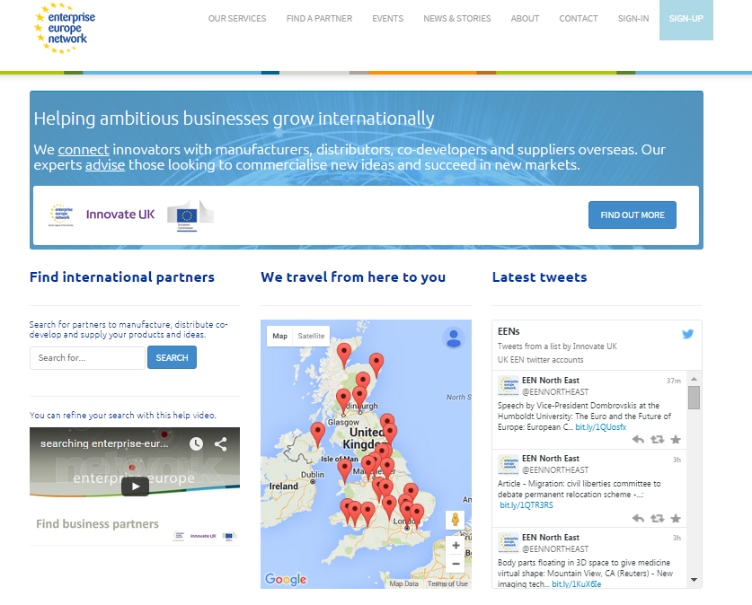
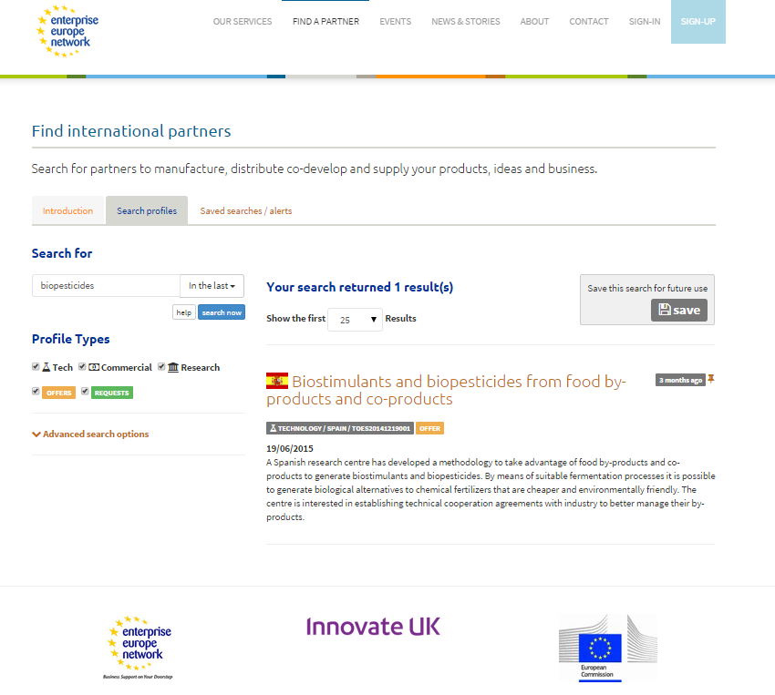

www.enterprise-europe.co.uk

Slide 8
EEN Support to Access Funding
Information and advice on sources of UK and European Funding
Including Horizon 2020, Eurostars, Innovate UK
Helping identify suitable ‘calls’ for your innovation
Partner and syndicate search/consortia formation
Pre-screening of applications
Thematic information events, seminars, one-to-ones and master classes
Horizon 2020 Key Account Management

Slide 9
UK Treasury Guarantee
Grants in progress (Register on Portal)
Bids submitted
National Replacement for SME Instrument
Coaching
Bid Screening
EU still open for business

Slide 10
New Opportunities
Global Business Innovation Programme
- Precision Medicine - China (Feb 2020)
- Digital Health – South Korea (Mar 2020)
Funding:
Trade Access Programme (£2500)
Score Cymru ‘Seed Fund’
Eureka

Slide 11
‘Innovate 2 Succeed’
Intensive business coaching to analyse and improve Innovation capacity.
Aimed at innovative, ambitious businesses with a long term vision and internationalisation plans.
5- 7 days of 1-1 coaching with an experienced innovation adviser.
Support to build a foundation for on-going innovation management.

Slide 12

 | Thank You
 | Lawson J Coombes EEN Programme Manager Tel: 01792 606705 E: l.j.coombes@swansea.ac.uk

