Slide 1

Sharp Services UK
Brexit Implications
Ian Morgan, General Manager 24th October 2019

Slide 2




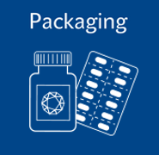



Sharp Services part of UDG Healthcare
4
1800
8
Operations in 4 countries
Employees
GMP & FDA registered facilities
Belgium Netherlands USA | UK
4
Part of UDG Healthcare plc
Areas of expertise
9000+ Employees
>$1 Billion net revenue
FTSE 250
Sharp US
Sharp EU
Sharp Clinical
Packaging
Since
1954

Slide 3
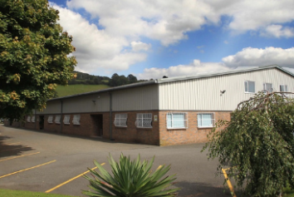
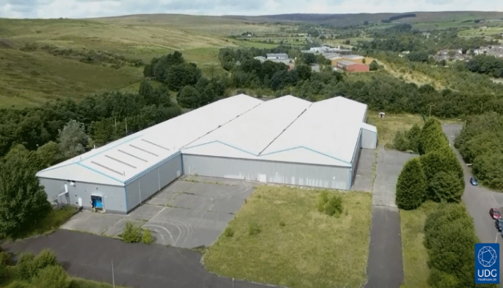
Sharp Services – Relocating for Growth
1988: DHP Ltd founded
2007: Expanded and relocated to Crickhowell
2012: Acquired by UDG Healthcare, rebranded as Sharp Services
  Greater capacity | Expanded services | A world-class facility
2017: UDG, Sharp purchased a brownfield site in Rhymney for £3.5 million
Dec 2017: £9.5M rebuilding project, with £500,000 support from the Welsh government
Oct 2018: Facility was completed
April 2019: Regulatory approval granted

Slide 4
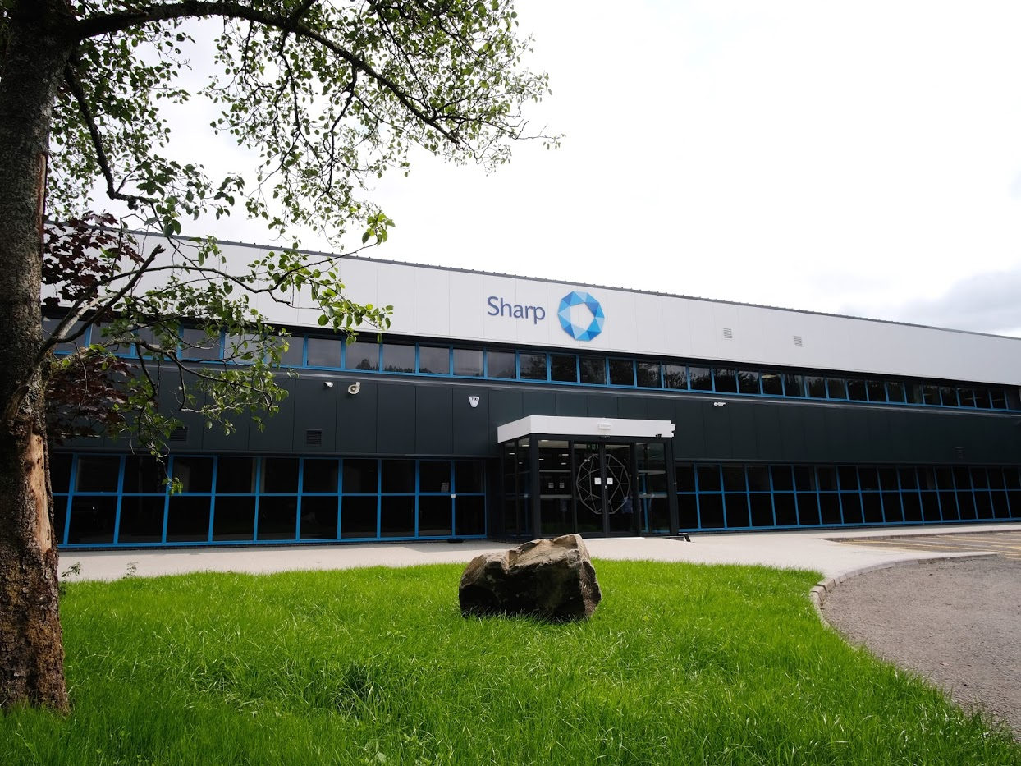
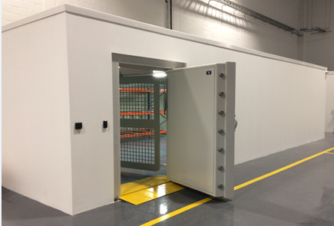


Sharp Services UK
  Facility Capacity
110,000 square foot facility
14 Manufacturing/production rooms
Walk-in storage refrigerator and -20C
Schedule I-V controlled drug storage
  Facility Capabilities
Blistering and bottling of tablets/capsules
Labeling of clinical trials
Global distribution of clinical trials

Slide 5
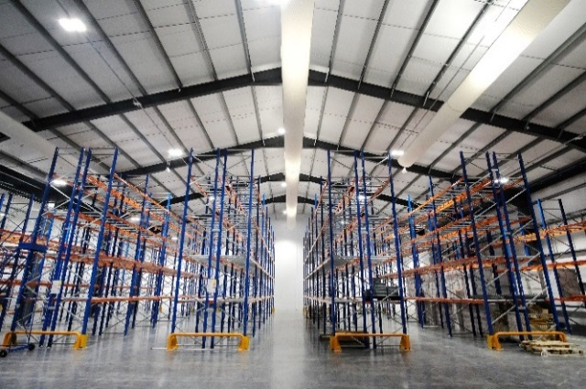
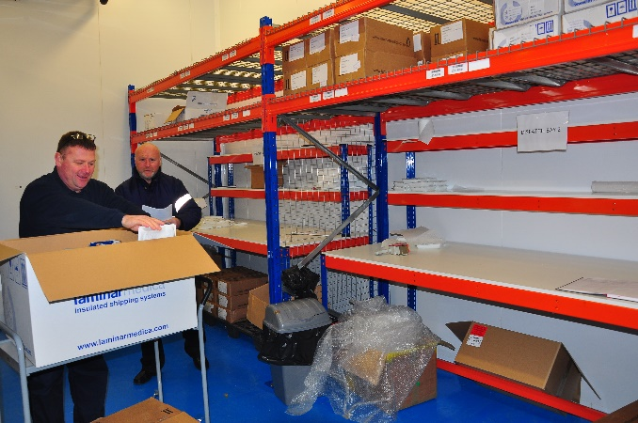
Release, Storage and Distribution Services
Storage
Controlled Temperature
Controlled Drug
Distribution within the EU
500 shipments/month temperature controlled
Product Release
UK currently classified as an EU release
Product imported into UK from outside the EU, release and shipped to EU trial sites

Slide 6
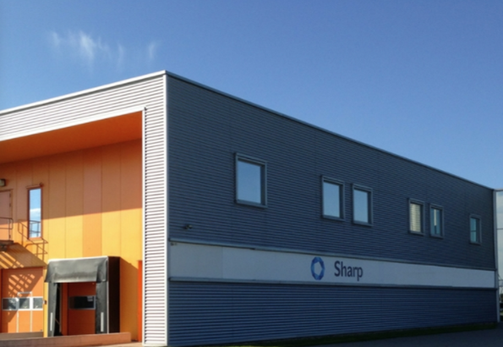
Impact of Brexit
Current solution
  Sharp is currently using an Ireland-based third party vendor for QP release services, storage and distribution
  Revenue is diverted to a 3rd party, approximately 25%
Sharp Heerenveen solution – The Netherlands
  License application approved by Dutch authorities
  First receipt and release pending distribution from Heerenveen
  Client projects to be supported by UK team
  Released by NL QP (Qualified Person)

Slide 7
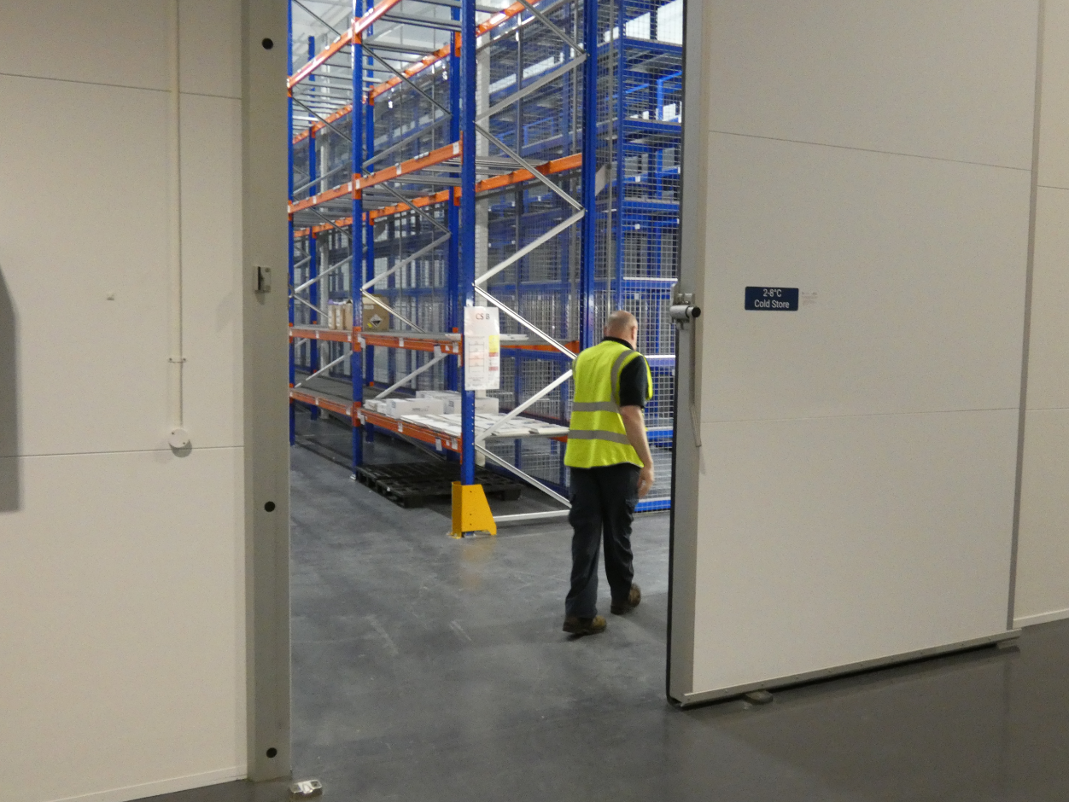
Tangible Lost Revenue due to Uncertainty
Customer | Amount
1 | £250,000
2 | £500,000
3 | £250,000
4 | £400,000
5 | £300,000
Total | £1,700,000
Number of project proposals decreased by 55% over last 12 months
2018 revenue from European distribution excess of £7 mil year
Review Sharp strategy to engage more packaging work with decrease in EU distribution
Shipments are time critical (patients drug) with potential delays in customs clearance

Slide 8

Regulatory Considerations
There are 2 options with regard to the release process:
  The site QP to recertify and produce their own certificate based upon the UK QP certificate. This option is dependent upon EU acceptance
  Sharp UK to employ a QP resident in The Netherlands for recertification and operational oversite
Clients will need to amend regulatory submissions to include The Netherlands site as a depot
Clients may wish to audit the facility

