Slide 1
Fresh look on sepsis biomarkers: the ICU consultant's perspective
Dr Tamas Szakmany

Slide 2
Our typical ICU patient on admission
Age ~67 years
APACHE II score: ~30
WCC 13-16
CRP: 20-150
Acute kidney injury: urea ~10, creatinine ~120-150
MAP ~ 65mmHg
On noradrenaline 0.05-0.5 mcg/kg/min
Urine output ~20 mL/hr
On mechanical ventilation with acceptable oxygenation

Slide 3
Is this patient septic?
Everybody wants simple Yes/No answers!
Early identification and assessment of severity of sepsis syndrome
Early diagnosis of organ dysfunction and optimal use of healthcare resources
Identifying patients at the time of hospital discharge who might benefit from further health resource allocation

Slide 4
Challenges
No universally accepted validated biomarkers for use in SIRS/sepsis discrimination despite a number of previous single and combination biomarker discovery/validation studies
No universally accepted validated biomarkers, including cytokines, for use in severity/prognosis despite a number of previous studies
No temporal and long-term prognosis studies conducted

Slide 5
ANEMONES: Analysis of geNe Expression and bioMarkers fOr poiNtofcare dEcision support in Sepsis
Collaboration with PHE, Randox, Atlas Genetics, Nottingham Trent, Cardiff University/SARTRE/Critical Care Alliance
Funded by Innovate UK (former Technology Strategy Board)
Temporal study of gene expression and protein biomarkers in three distinct patient populations
ISRCTN 99754654
MREC N° 12/WA/0303
UKCRN ID 13675

Slide 6
Our patients
Pulmonary Abdominal OOHCA
n=82 n=61 n=42
Age 67 (17) 72 (21) 68 (17)
APACHEII 31 (17) 31 (13) 30 (8)
WCC 16.4 (9.4) 15.2 (15) 14.9 (12.8)
CRP 162 (180) 256 (189) 26 (49)
Mean BP 65 (18) 65 (13) 61 (12)
Mortality 18.3% 24.6% 33.3%

Slide 7
Data mining
Data mining conducted on previous SIRS/sepsis datasets from E GEO database and prior art (NTU and PHE)
3 control genes identified from interrogation of datasets; ALAS1, TBP & HMBS, for normalisation purposes
6 surrogate candidate biomarkers and 2 control gene identified and passed to Atlas for their assay design; Biomarker 1-3 and HMBS utilised
48 biomarker and 3 control gene candidates selected from prior art analysis for validation using qPCR at PHE (plate configurations 1 and 2)
5 qPCR plate configurations were used In total, plates 3-5 were selected through interim analysis of microarray hybridisation data (120 total biomarkers)

Slide 8
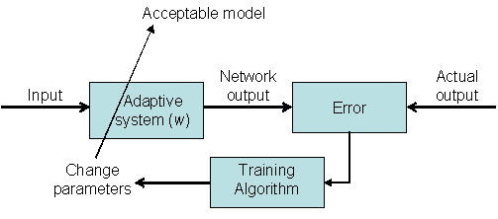
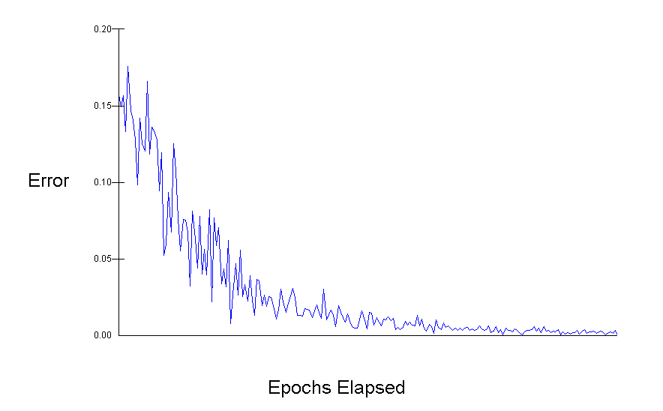
ANN model development
► Train the ANN
1. Present data for a Single Gene to the ANN.
2. ANN computes an output.
3. ANN output compared to desired output.
4. ANN weights modified to reduce error.
► Test the network
1. Present blind (selection) data to the training ANN.
2. ANN computes an output based on its training for selection data.
3. Stop training when ANN performance on selection data fails to improve for x epochs.

Slide 9
Data mining
Biomarker 1

Slide 10
Genetic biomarkers
Final Draft Selection - 112 biomarkers
General Inflammation
SIRs/Sepsis Discriminatory
Abdominal vs Pulmonary (IFN/classical complement)
Severity/Recovery
Organ damage
Long-term prognosis

Slide 11
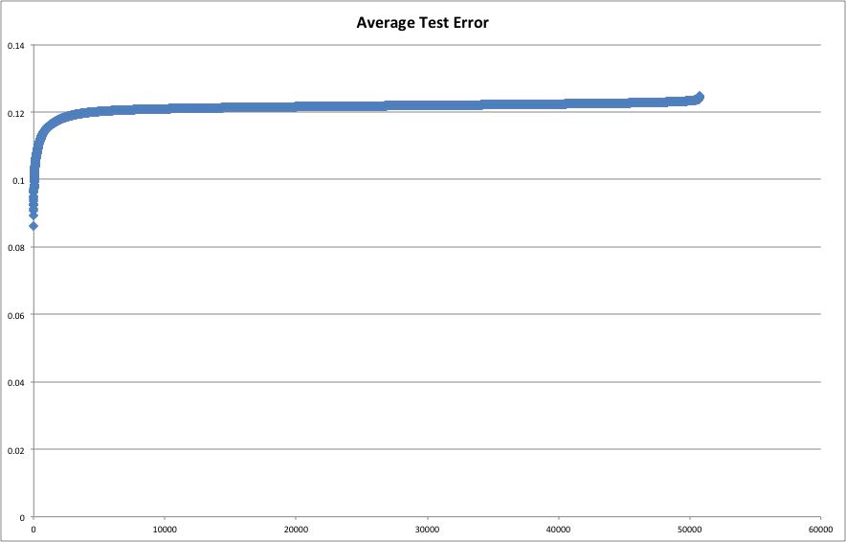
Initial screen
Expression array data screened for probes having:-
  Good expression range
  A good fold change difference
  ANN model predictability
721 probes identified.
ANN multi gene models built for:-
  Sepsis vs. SIRS (day 1 samples)
  Abdominal vs. Pulmonary (day 1 samples)
  Sepsis Survival (day 1 samples)

Slide 12
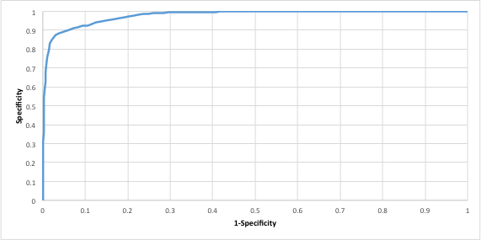
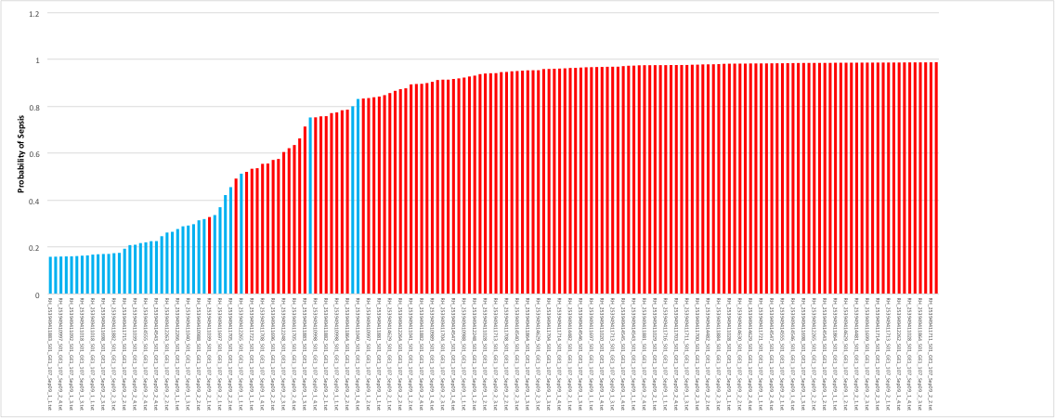
Model 1 Sepsis versus SIRS (OOHCA)
Average AUC = 0.981

Slide 13
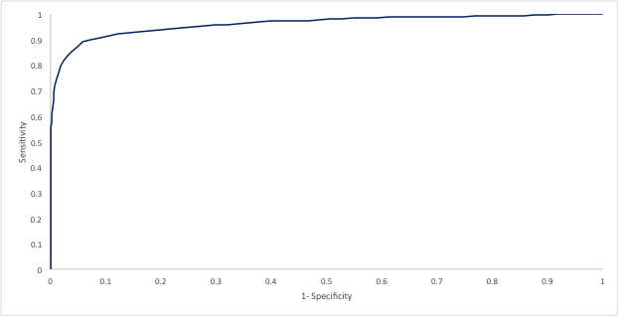
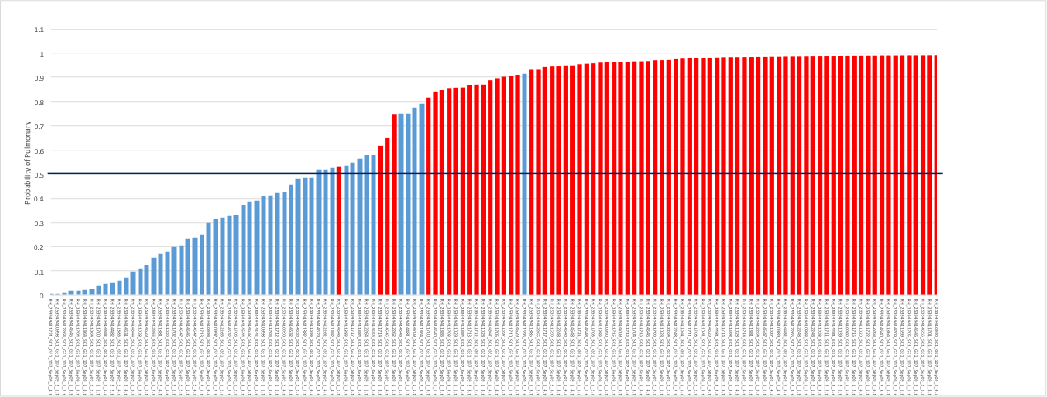
Model 2 Abdominal versus pulmonary Sepsis
Average AUC =0.96

Slide 14
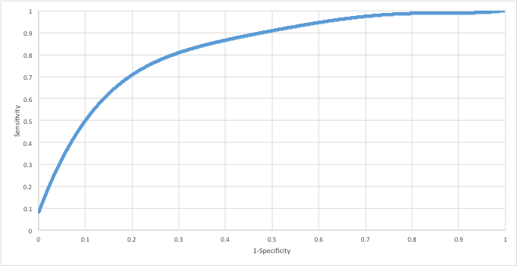
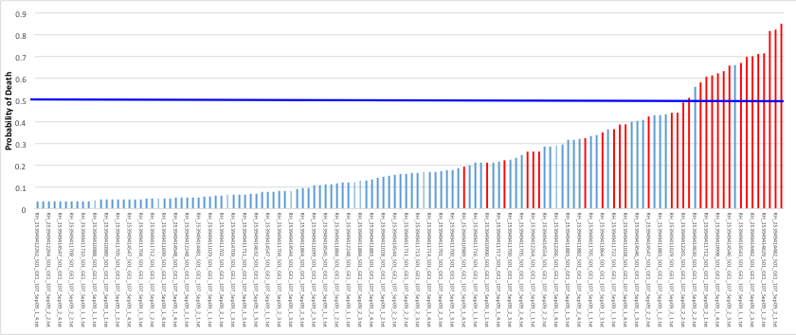
Model 3 Survival in sepsis (Profile Day 1)
Average AUC = 0.85

Slide 15
Results - Protein arrays

Slide 16
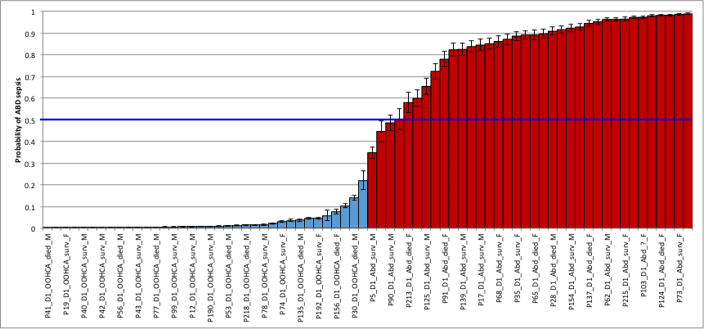
Model 1 Abdominal Sepsis versus SIRS (OOHCA)
 | Input ID | Average Test Error
1 | CRP | 0.062778
2 | TNFRII | 0.048854
3 | ALT | 0.040314
4 | FABP_C | 0.037093

Slide 17
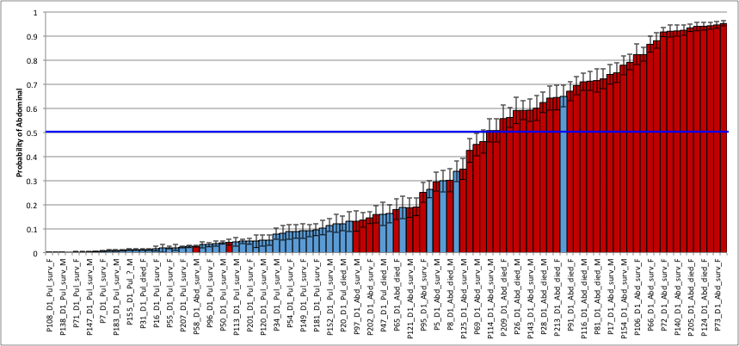
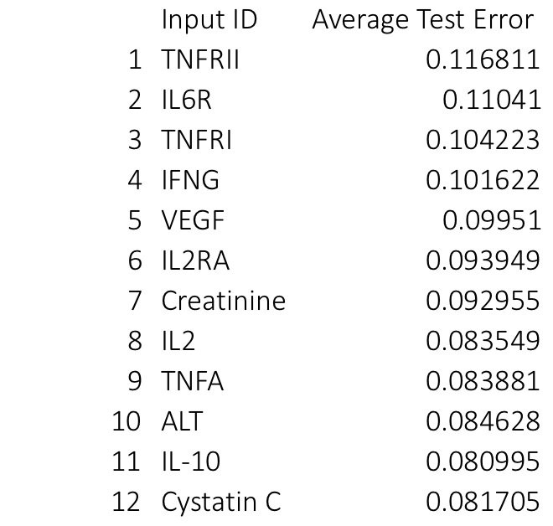
Model 1 Abdominal Sepsis versus Pulmonary Sepsis

Slide 18
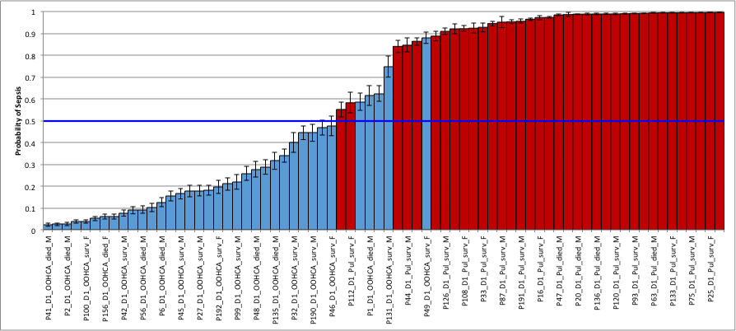
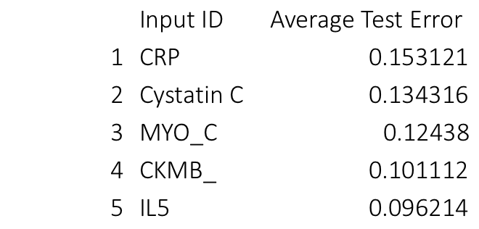
Model 1 Pulmonary Sepsis versus SIRS (OOHCA)

Slide 19
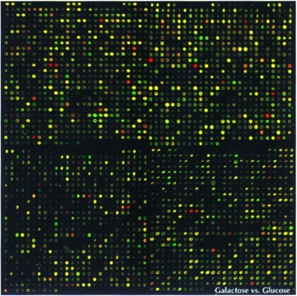
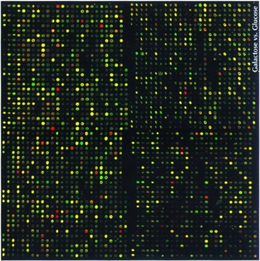
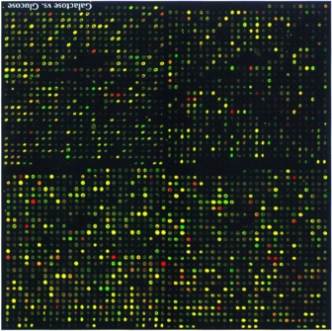

Profile Data
Key Genes in
ANN decision support model
Diagnosis A
Treatment B
Patient
Population
Stratified population

Slide 20
Our patients
Pulmonary Abdominal OOHCA
n=82 n=61 n=42
Age 67 (17) 72 (21) 68 (17)
APACHEII 31 (17) 31 (13) 30 (8)
WCC 16.4 (9.4) 15.2 (15) 14.9 (12.8)
CRP 162 (180) 256 (189) 26 (49)
Mean BP 65 (18) 65 (13) 61 (12)
Mortality 18.3% 24.6% 33.3%

Slide 21
New way of thinking
Control
SIRS/sepsis
Panel 1 (2 markers)
Panel 4 (3-4 markers)
– Severity/Recovery
Sample
Panel 2 (3 Markers)
Panel 3 (3 markers)
PLM Sepsis
Sepsis
ABD Sepsis
SIRS

Slide 22
Next steps
Patent applied for
Publication of current data
Validation study
Biomarker discovery based on principles outlined
Extend/amend the panels for different questions

